Slide 1
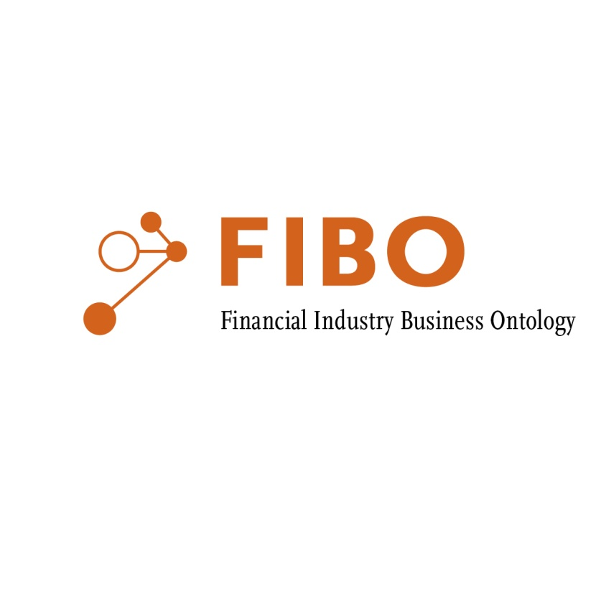

Financial Industry Semantics and Ontologies
The Universal Strategy: Knowledge Driven Finance
Financial Times, London
30 October 2014

Slide 2
Semantic Challenges
"Where is the wisdom we have lost in knowledge?
Where is the knowledge we have lost in information?"
- T. S Eliot

Slide 3
Syntax is not Semantics
Meaning is not Truth

Slide 4
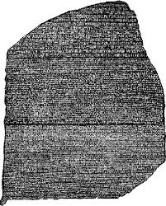
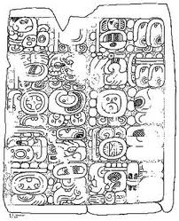
Approaches to Meaning
Rosetta Stone
Mayan Language

Slide 5
Approaches to Meaning
Rosetta Stone
Mayan Language
Existence of already-understood terms enabled translation
Semantics grounded in existing sources

Slide 6
Approaches to Meaning
Rosetta Stone
Mayan Language
Existence of already-understood terms enabled translation
Semantics grounded in existing sources
No existing common language to enable translation
Translation was possible only from internal consistency of concepts

Slide 7
Rosetta Stone: Semantic Networks
Directed Graph
The meaning at each node is a product of its connections to other nodes
Semantically grounded at certain points in the graph

Slide 8

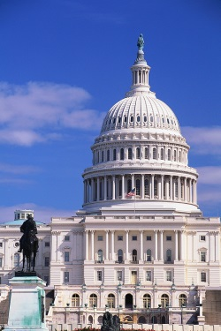

Semantic Grounding for Businesses
What are the basic experiences or constructs relevant to business?
    Monetary: profit / loss, assets / liabilities, equity
    Law and Jurisdiction
    Government, regulatory environment
    Contracts, agreements, commitments
    Products and Services
    Other e.g. geopolitical, logistics
Notes:
AKA where does the meaning get in?
Business: Grounded in the realities and sensory inputs of the organization
Monetary: profit, loss, assets
Legal: regulatory, legal environment
Ecosystem: Agreements with other organizations
Contractual and agreement
Products and services
Other e.g. jurisdiction, geopolitical

Slide 9
Where does this lead?
Taxonomy of kinds of contract
Taxonomy of kinds of Rights
  Rights, Obligations are similar and reciprocal concepts
  Note that these don’t necessarily correspond to data
Semantics of accounting concepts
  Equity, Debt in relation to assets, liabilities
  Cashflows etc.
Semantics of countries, math, legal etc.

Slide 10
Mayan: Internal Consistency
Graph has logical relations between elements
These correspond to the relations between things in reality
Automated reasoning checks the “deductive closure” of the graph for consistency and completeness

Slide 11


Mayan: Internal Consistency
Graph has logical relations between elements
These correspond to the relations between things in reality
Automated reasoning checks the “deductive closure” of the graph for consistency and completeness

Slide 12
FIBO Ontologies:
Conceptual and Operational
Conceptual Ontology
Operational
Ontologies
Use Case neutral
Meaning expressed in the “Language of the business”
Formally grounded in legal, accounting etc. abstractions
Use case specific classes, properties
Optimized for operational functions (reasoning; queries)
Addition of rules
Mapping to other OWL ontologies
Classes and properties
Definitions
Namespaces
Annotations

Slide 13
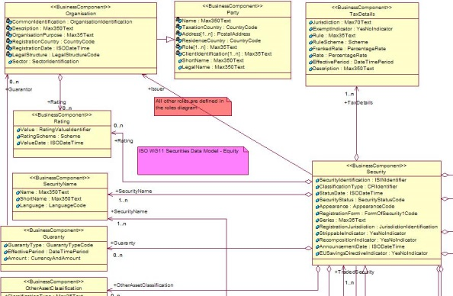
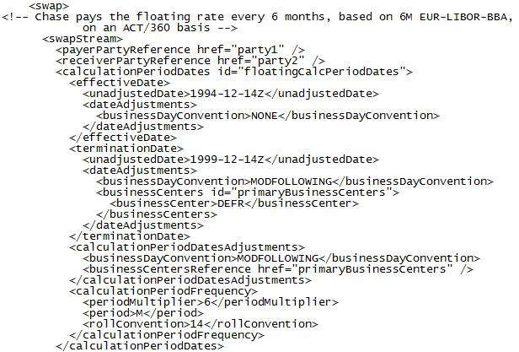
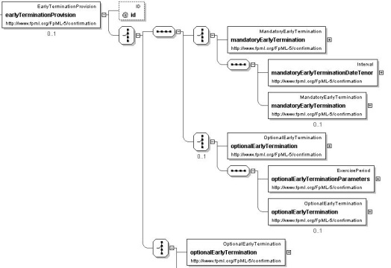
Developing FIBO
Conceptual ontology
Shared business meanings

Slide 14

Developing FIBO
Conceptual ontology
Shared business meanings
Validated by business

Slide 15
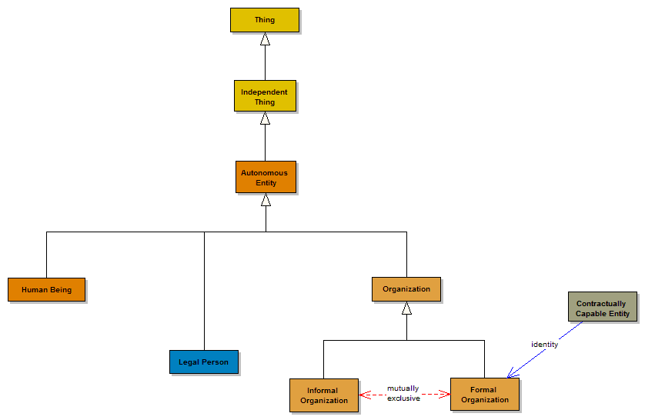
Developing FIBO
Conceptual ontology
Shared business meanings
Expressed logically
Validated by business

Slide 16
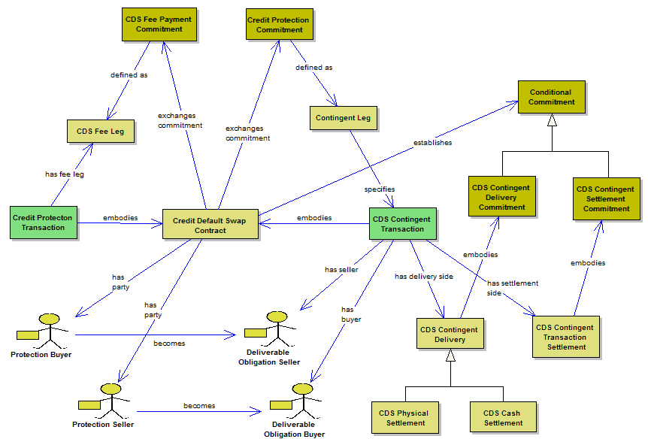
Example: Credit Default Swap (CDS)

Slide 17
Financial Industry Business Ontology (FIBO)
Business Entities
  Legal entities, ownership hierarchies, LEI,
Securities
  Tradable securities - equity, debt securities, reference data terms
Loans
  Retail lending, corporate, credit facilities
Derivatives
  Exchange traded and over the counter derivative trades, contracts and terms
Market Data
  Date and time dependent pricing, analytics
Corporate Actions
  Corporate event and action types, process
Annotation metadata
  Provenance. mapping, rulemaking
Business Entities
Securities
Loans
Derivatives
Market Data
Corporate Actions
Metadata

Slide 18
Using FIBO
EXTEND
Firm’s Business Conceptual Ontology
DEPLOY
App
App
App

Slide 19
Actually…
EXTEND
Firm’s Business Conceptual Ontology
DEPLOY
App
App
App

Slide 20

Deploying BCO
Firm’s BCO
Adapters
DEPLOY
DEPLOY
Common Logical Data Model
Operational Ontologies
Operational Ontologies
Operational Ontologies
Local LDMs
Local LDMs
Triple Store

Slide 21
Regulatory Reporting Use Case
Need for “Common Language”
  OFR, BoE and others
  What do we mean by “language” here?
Bank of England Proof of Concept

Slide 22
Regulatory Reporting Current State
?
Reports (forms)
FORMS
FORMS
REPORTING ENTITY
REGULATORY AUTHORITY

Slide 23
Regulatory Reporting Current State
?
Reports (forms)
FORMS
FORMS
REPORTING ENTITY
REGULATORY AUTHORITY
Change in Reporting requirements =
Redevelopment effort
  By each reporting entity
  For each system and form
Uncertainty
Content of the reports
  Are we comparing like with like?
  Data quality and provenance

Slide 24
Regulatory Reporting with Semantics
!
Thing
Contract
IR Swap
CDS
Bond
Granular
data
Thing
Contract
IR Swap
CDS
Bond
Common
ontology
Common
ontology
REPORTING ENTITY
REGULATORY AUTHORITY
Data is mapped from each system of record into a common ontology
Reported as standardized, granular data
Agnostic to changes in forms
Receives standardized, granular data aligned with standard ontology (FIBO)
Uses semantic queries (SPARQL) to assemble information
Changes to forms need not require re-engineering by reporting entities

Slide 25
Thank you!
Mike Bennett
  Semantics Lead, EDM Council
  Director, Hypercube Ltd.
  www.edmcouncil.org
  www.hypercube.co.uk/edmcouncil

