Slide 1


FIBO Conceptual Methodology
Further exploration of conceptual Modeling Principles
FDTF Day 2, 17 Sept 2014

Slide 2
Purpose of this Session
FIBO Conceptual Domain Ontology Modeling
  Principles of conceptual FIBO
  Exploration of model type distinctions in the literature
  A look at what we have and how we intend to manage this in relation to the OMG submissions
  Abstraction and Reuse
  Implications for Externality Review

Slide 3
Two Things:
Syntax is not Semantics
Truth is not Meaning

Slide 4
Consider the Dictionary

Slide 5
Consider the Dictionary

Slide 6
Consider the Dictionary
Where does the meaning get in?

Slide 7
Semantic Networks
Directed Graph
The meaning at each node is a product of its connections to other nodes
So where does the meaning get in?

Slide 8
Semantic Networks
“Symbol Grounding”

Slide 9

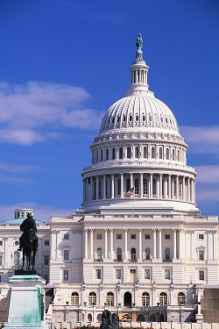

Semantic Grounding for Businesses
What are the basic experiences or constructs relevant to business?
    Monetary: profit / loss, assets / liabilities, equity
    Law and Jurisdiction
    Government, regulatory environment
    Contracts, agreements, commitments
    Products and Services
    Other e.g. geopolitical, logistics
Notes:
AKA where does the meaning get in?
Business: Grounded in the realities and sensory inputs of the organization
Monetary: profit, loss, assets
Legal: regulatory, legal environment
Ecosystem: Agreements with other organizations
Contractual and agreement
Products and services
Other e.g. jurisdiction, geopolitical

Slide 10
Making it Meaningful
Putting something into RDF/OWL does not make it meaningful
So, what is a meaningful model
  1. Formal relationship between model and subject matter:
    “Everything is a Thing”
  2. Formal notation grounded in common logic
  3. Abstraction of kinds of thing into their simplest possible building blocks
    Contracts, Parties, Legal Entities etc.
  4. Deductive Closure: Formal logical relations among the concepts
  5. Symbol Grounding: Assertion of meaning for core abstractions in the model

Slide 11
Business Semantics
Thing
Contract
Security
Derivative
Party
Issuer
Asset
etc.
OWL “Thing”:
Everything in the model is some thing in the world
Taxonomic hierarchy:
Things classified according
to their properties
OWL Thing: The ontology makes a specific commitment to being a model of things in the world
Classes of thing are classified according to their properties
  Additional properties
  Restrictions on existing properties
Classes may also be defined “extensionally” as a list of members
Notes:
Ontology: a formalization of real world business concepts
[diagram]
owl:Thing – everything is a Thing
Class: set theoretic construct
Class membership defined
Intensionally: by properties
Extensionally: as lists of members (e.g. currency)

Slide 12
Applying Meaning to Financial Semantics
Everything is a Thing
  What kind of Thing?
  What distinguishes it from other things?
What kind of Thing?
  Share is a Security is a Transferable Contract … is a Contract
What properties?
  Share gives the holder some Equity
  Share confers on the holder some Voting Rights

Slide 13
Where does this lead?
Taxonomy of kinds of contract
Taxonomy of kinds of Rights
  Rights, Obligations are similar and reciprocal concepts
  Note that these don’t necessarily correspond to data
Semantics of accounting concepts
  Equity, Debt in relation to assets, liabilities
  Cashflows etc.
Semantics of countries, math, legal etc.

Slide 14
FIBO Formalism – in plain language
The model consists of:
  Things
    A Thing is a set theory construct
    Arranged in a hierarchy called a “Taxonomy”
      Like taxonomy of species
  Facts
    Simple facts (names, dates etc.)
      e.g. “Issue Date” is a date
    Relationship Facts (relate one thing to another thing)
      e.g. “Share confers Voting Rights”
      Things so referenced are also in taxonomic hierarchies
  Other set theory concepts
    Disjoints, Unions
Notes:
The theory of meaning which we have applied needs to be described in plain English to model reviewers in the business domain, so that they can validate it, add terms to it and so on. Since the underlying logical formalism is basically that of set theory, this is relatively simple. We describe the model in the terms shown above.
This is all that reviewers need to know. They also need to be shown what are the model constructs which represent the above logical assertions.
That’s it.

Slide 15
FIBO Semantic Abstractions
Inevitable by-product of the “What kind of Thing is this?” question
  Ontologies are built around a classification hierarchy (“Taxonomy”) of kinds of thing
  This is key to meaningful ontologies
Enables disambiguation across business contexts
Not a technology activity
Examples: Contract, Credit, Asset etc.

Slide 16
Overview of Classification Theory
“Classification”
  a system that employs a “meaningful clustering” of items
    Kwashnik (1999)
  the “orderly and systematic arrangement” of items into a “system of mutually exclusive and nonoverlapping classes”
    Jacob (2004)
There are various kinds of classification

Slide 17
Classification Requirements
Classification schemes may be
  Monohierarchical
  Polyhierarchical
Polyhierarchical classification depends on multiple inheritance
  one class may have several parents
    A whale is both a marine animal and a mammal
    An IR Swap is both a Swap Contract and an Interest Rate Derivative
There is no one right way to classify

Slide 18
Semantics Re-use
Research and identify re-usable content semantics
  In formal published ontologies
  Business models in non ontological (non FOL) formats
  Technical / messaging standards to “reverse engineer” into semantics
Pre-requisite: identify abstractions needed to support the specification concepts
Examples:
  Transaction semantics
  Legal / contractual etc.
  Real Estate (for mortgage loans)

Slide 19
Re-use Examples
Derivatives:
  Needs Transaction Shared Semantics
    Extends Foundations model of commitments, agreements etc.
    In line with ISO 15944-4 (REA)
  Other e.g. Margining, Collateral
Securities, Derivatives have Schedules
  Phase 1 of OMG Date Time Vocabulary alignment
    Now available in OWL
    Shared Semantics strategy
Funds / CIV: FIBO-BEs update in Trusts, Entities
SPVs: FIBO-BE update to add core SPV model
Temporal Terms
  Phase 2 of OMG DTV alignment

Slide 20
FIBO Mid Level Ontologies
Roles, Parties, Parties in Roles
Transactions
Legal and jurisdictional concepts
Contractual
Geo
Social constructs
Accounting abstractions
Time
Business Process

Slide 21
Other Cross-domain Concepts
These are sections in the FIBO EA “Global Terms” set but not yet in the OMG Foundations spec:
  Math
  Information
  Risk
  Service provision (in the “Business” catch-all section)
  Payments (in the “Business” catch-all section)

Slide 22
Externality Reviews
How the above is applied for the FIBO Process
  Identifying Abstractions
  Re-use of available industry ontologies

Slide 23
Semantics Re-use in FIBO BCO
Research and identify re-usable content semantics
  In formal published ontologies
  Business models in non ontological (non FOL) formats
  Technical / messaging standards to “reverse engineer” into semantics
Pre-requisite: identify abstractions needed to support the specification concepts
Examples:
  Transaction semantics
  Legal / contractual etc.
  Real Estate (for mortgage loans)

Slide 24
Externality Reviews
Changes to the Business Conceptual Model that will (likely) never see the OMG process.
Changes required in existing OMG standardized components (FND, BI)
Domain-specific set of ontologies selected for standardization
Dependencies on external ontologies that are themselves standards, e.g., ISO 20022.
Changes required in future OMG standardized ontologies, e.g., known dependencies on Corporate Actions
Changes required in FIBO components currently under way, e.g., Indices and Indicators.

Slide 25
Externality Review Process
Externality Team works with FIBO Content Team to identify the required abstractions
  Placeholder abstractions in legacy FIBO
  Additional abstractions requirements
Look for suitable “Community of Practice” semantic sources
Identify treatment within FIBO models
  Adopt / Snapshot / Reference
  Disposition of concepts under existing upper and mid-level ontologies (FIBO-FND Annex B Treatments)

Slide 26
Further Explorations…

Slide 27
Considerations in Conceptual versus Operational Ontologies
These next few slides are an exploration of some ideas that are coming through in the literature (not solid positions at this point but stuff to think about)
  Approaches to Semantics and Ontology
  Dimensions of a Model
  Framing the Ontology Type (model theory)
  Datatypes considerations
  Property Reuse considerations

Slide 28
Two approaches to Semantics
Deductive Closure: The logical relationships among given set of concepts represents a coherent meaningful model
Symbol Grounding: Meaning is asserted at certain points in the model, with other model content semantics defined in relation to these
These are complementary: the model logic (restrictions etc.) provides the basis for deductive closure and defines the relationships among concepts

Slide 29
Two Approaches to Ontology Development
Approach 1: For a each concept, identify a suitable label, find a suitable definition in a dictionary, and take this definition as representing the concept
  Add properties and restrictions as required
Approach 2: In order to support a given set of industry-specific concepts, arrive at a high level abstract concept of which that and other concepts are specializations.
  Think of a suitable label which could reasonably label that abstraction.

Slide 30
Two Approaches to Ontology Development
Approach 1 is a vocabulary-centric approach
  Suitable for operational ontologies as these rely on deductive closure not symbol grounding for semantics
Approach 2 is an business semantics approach
  Suitable for standardization of meaning
  Common in non-OWL business models
FIBO BCO uses Approach 2
The business semantic approach requires that the developer holds in his or her mind a meaning without relying on the use of any one word to frame that meaning.

Slide 31
Framing the Ontology
There are various views of this in the literature
  Some see the segregation of operational and conceptual as axiomatic
  Some don’t agree with it at all
At issue is partly the matter of what is the model subject matter – real things or data about real things or both

Slide 32
Ontology Types
Paper: “Towards an Ontology for Conceptual Modeling”
  (McCusker, Luciano and McGuinness)
Suggestions and issues raised:
  Types of Ontology
  Metamodel considerations
  Namespace considerations

Slide 33
McCusker, Luciano and McGuinness
A three-layer system (Smith et al*) for:
  things in the world,
  our ideas of them
  representations of those ideas
These give 3 types of ontology:
  Level 1: the objects, processes, qualities, states, etc. in reality (for example on the side of the patient);
  Level 2: cognitive representations of this reality on the part of researchers and others;
  Level 3: concretizations of these cognitive representations in (for example textual or graphical) representational artifacts.

Slide 34
Namespace Considerations
In the above paper, one of the considerations in comparing conceptual ontologies and those used at the logical level is:
  Distinction from Logical Models: A conceptual model and its vocabulary must not be represented in the same metamodel as a logical model. Doing so in metamodels that support reasoning may allow for direct inferences between conceptual and logical layers. This can have unintended consequences, for example, in cases where the logical and conceptual models are both expressed in OWL. If the logical model has classes that are subsumed by conceptual model classes, then it no longer becomes clear if the instance is referring to an instance of a thing, or an instance of an idea of a thing.
Suggestion: Can we use the same metamodel (OWL) IFF the namespaces are separate?

Slide 35
FIBO Model Considerations
OMG FIBO submissions are application ready
  Similar style to Logical Model
  Represents data about things in the world
    Datatype properties
FIBO BCO represents the problem domain
  But also has XML datatypes
  We might re-think this

Slide 36
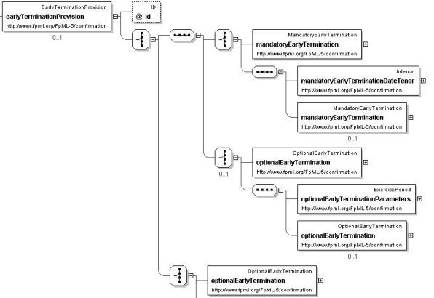

Dimensions of a Model
Application
MODEL
e.g. Messaging Level
Model Theoretic Relation (grounding)
Formalism
e.g. First Order Logic
e.g. Business domain (business process etc.)

Slide 37
Dimensions of any Model
1. Formalism:
  How are the things in the model modeled?
2. Model Theory (semiotics):
  What are things in the model, a model of?
3. Application:
  How does the model relate to development of solutions?
  Meta-level abstraction etc.

Slide 38
Model Theoretic Aspects
“What is the relationship between each of the constructs in the model, and the thing it represents?”
Examples
  Business domain concepts
  Program code
  Database fields
  Message elements

Slide 39
Model Formalism
“What is the formal basis of the elements in the model?”
Examples
  Math
  Formal logics
    First Order Logic
    Modal / deontic etc. logic
    Rules
  Object oriented constructs
  Data storage constructs
  Programmatic logic

Slide 40
Model Positioning
Computationally Independent
Model (CIM)
Realise
Platform Independent
Model (PIM)
Implement
Platform Specific
Model (PSM)

Slide 41
Model Positioning
Computationally Independent
Model (CIM)
Business
Realise
The Language Interface
Platform Independent
Model (PIM)
Technology
Implement
Platform Specific
Model (PSM)

Slide 42
Model Positioning
Computationally Independent
Model (CIM)
Business
Realise
The Language Interface
Platform Independent
Model (PIM)
Technology
Implement
Platform Specific
Model (PSM)
Validation of the conceptual model

Slide 43
Conceptual Model for Data
Ontology
Business
Realise
The Language Interface
Logical Data Model
Technology
Implement
Physical Data Model
Validation of the ontology
with example data

Slide 44
Dimensions of a Conceptual Model
Model Formalism:
  Any technology independent formalism
  First Order / Higher Order Logic is good
Model Theory:
  Everything in the model should represent something in the business domain
Model application:
  Provides technology-neutral view of some aspect of the problem domain
  Point of reference for solutions implementers

Slide 45
Conceptual Model Requirements
Must be owned and validated by business
  Manage the “Language interface” between tech and business subject matter experts
  Everything should be in English
    No techie terms and casing like “objectProperty”
  Everything should be reviewable
    Spreadsheets
    dialect-free diagrams

Slide 46
FIBO as DSL
A number of features of the legacy FIBO models were intended to provide a Domain Specific Language for the industry. These include:
  Archetypes
  Drag and drop editing / placement of those
Other important aspects of DSL:
  Explicit model theory (semiotics)
New possibles
  Use of RDA Types Registry? (to consider)

Slide 47
OWL as Conceptual Ontology
OWL as a means both for conceptual and operational ontologies …

Slide 48
Conceptual and Physical Ontologies
Business Conceptual
Ontology (CIM)
Business
The Language Interface
Extract and Optimise
Technology
Operational Ontology
(PSM)

Slide 49
Types and Datatypes
Data types
Business Conceptual
Ontology (CIM)
Business
The Language Interface
Extract and Optimise
Technology
Data types
Operational Ontology
(PSM)
Platform specific matter

Slide 50
OWL Datatypes
These are XML Schema datatypes
  Only a sub-set of XML Schema datatypes are supported
OWL datatype provision therefore very limited
Examples:
  11am LIBOR – uses dateTime in FIBO-IND
  Coupon date – want to use XML gDayMonth – not in OWL
  Dates in general: have had to enforce the use of dateTime with midnight times in data where only a date is intended
This is not at all like a computationally independent model

Slide 51
Information Kinds
Business: what are the kinds of information which exist independently of how IT systems codify them?
  Names
    Codified as text but what are they?
    Consider edge cases e.g. Menzies JHWH, TAFKAP
  Yes/No, Yes/No/Maybe, Lists of possibles
  Numbers
  Dates
    Date is an identifier for a day
    Calendar is the identification scheme
  Many others…

Slide 52
Information Kinds and Datatypes
Research Data Alliance: Types registry
Defines types as real world semantics
Has the ability to register, reuse real world types
There is also a similarity here with previous FIBO work:
  Archetypes (where does type registry end and archetypes begin?)
  Referenceable archetypes (Monetary Amount etc.)

Slide 53
Types and Datatypes
Suggestion: Conceptual ontology would only use “types” which are some real world kind of thing
  Example: Date v DateTime datatype
Similar questions have arisen in Address
Some real world types ARE text or number
  Others are not: I was not born in a string

Slide 54
Re-use of Properties
In OWL, a property is a first class element
  Like a class
Properties are intended to be re-used where possible
Re-use is via restrictions
Properties may also be derived from other properties
Properties may be inverse of other properties
OWL also defines types of properties e.g. symmetric, transitive and others…

Slide 55
Use and Re-use of Properties
Two approaches:
  Create a sub property
  Create a restriction on the property
Guideline:
  Does the new property introduce a distinct new meaning?
    Make it a sub-property of a more general property
  Does the new property simply reassert an existing meaning, with reference to some other class or with some new range?
    Create a restriction on the original property

Slide 56
What is a Restriction?
Restriction

Slide 57
What is a Restriction?
  A restriction is a set of things just like a class
  It is the set of all things which there are which have the property as restricted…
Restriction

Slide 58
What is a Restriction?
  There are three kinds of restriction
Restriction

Slide 59
What is a Restriction?
  There are three kinds of restriction
  And two ways in which a restriction may be applied
    Actually three…
Restriction

Slide 60
What is a Restriction?
  Restriction is applied to some property
uxoriates
On property
Restriction

Slide 61
What is a Restriction?
  There are three kinds of restriction
    1. All values from
  This is the set of all things having the property, where the target (range) of that property may only be the designated class
uxoriates
On property
may only be
Some Thing
Restriction
OWL: allValuesFrom

Slide 62
What is a Restriction?
  There are three kinds of restriction
    2. Some values from
  This is the set of all things having the property, where at least some of the occurrences of that property must have as their target (range), something from the designated class
uxoriates
On property
must be some
Some Thing
Restriction
OWL: someValuesFrom

Slide 63
What is a Restriction?
  There are three kinds of restriction
    3. Cardinality Restriction
  This is the set of all things having the property, where at occurrences of that property must have as their target (range), the multiplicity (cardinality) shown, from the designated class
    If no class is given, the multiplicity applies to the unrestricted range
uxoriates
On property
taken from
Some Thing
Restriction
Min=1
OWL: onClass

Slide 64
What is a Restriction?
    1. Necessary Condition
  There are two ways of applying a restriction
  Your Thing is a member of the set of all things which have the property as restricted
  This means that the restriction is a necessary condition for membership of Your Thing
Restriction
OWL: subClassOf
Your Thing

Slide 65
What is a Restriction?
    1. Sufficient Condition
  There are two ways of applying a restriction
  Your Thing is equivalent to the set of all things which have the property as restricted
  This means that the restriction is a necessary and sufficient condition for membership of Your Class (everything in the restriction is in Your Thing and vice versa)
Restriction
OWL: equivalentClass
Your Thing

Slide 66
What is a Restriction?
    3. As range of another restriction
  There are actually three ways of applying a restriction:
  In this case the allowable range of the restricted property is itself another restriction
  Use with caution; parse with care and test with test data!!
Restriction
Restriction
all values from / some values from / on class

Slide 67
Restrictions Presentation
All of the above illustrations describe the model constructs as model constructs
For a business facing view this is inappropriate – you need to describe the subject matter using the model constructs, you should not describe the model as a model
Easier said than done – there is still no clear consensus means for presenting the implication of a restriction to a business audience…

Slide 68
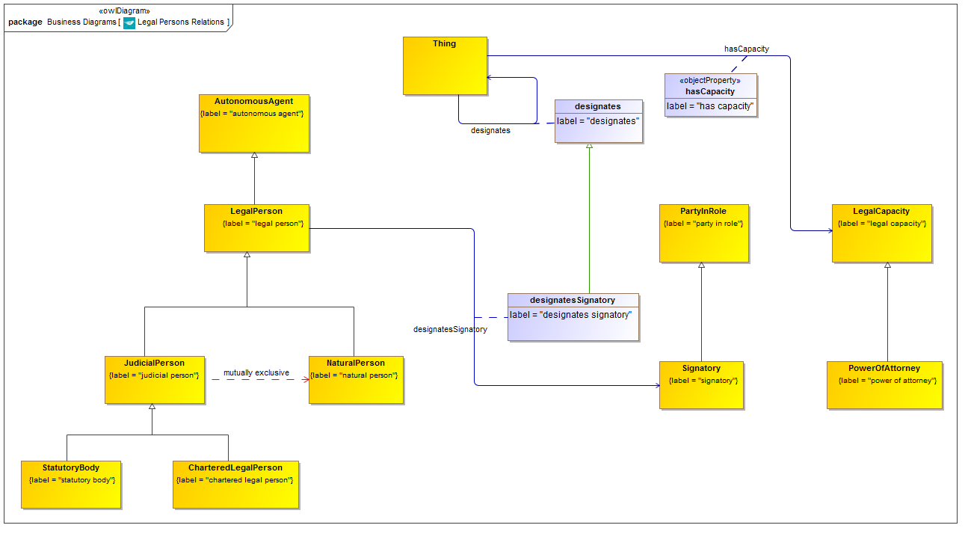
Sub-property Example

Slide 69
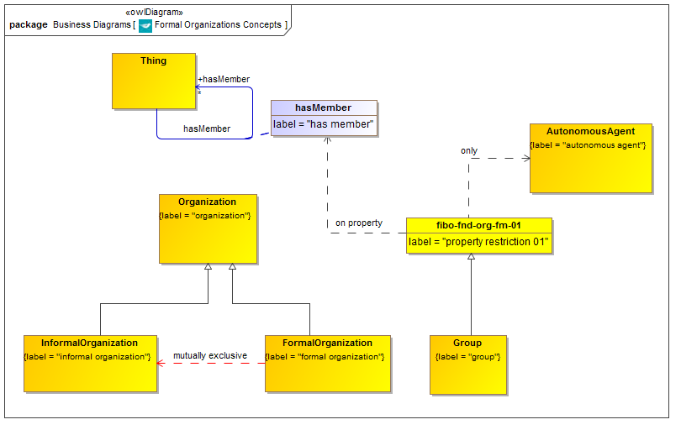
Restriction Example

Slide 70
Property Domains and Ranges
Properties with no domain and / or range
  Defaults to “Thing” (the universal class)
What is best practice
  in application ontology design?
  for common business meaning?

Slide 71
Property Domains and Ranges
1. Stand-alone application:
  Make the domain and / or range as general as possible (e.g. Thing) so it can be reused later
  This fits with the “vocabulary” approach to OWL application development
2. Common Language ontology (e.g. FIBO, FIBO extensions):
  Domain: the most general class of thing which could possibly have this property
  Range: the most general class of thing in terms of which this property may be framed

Slide 72
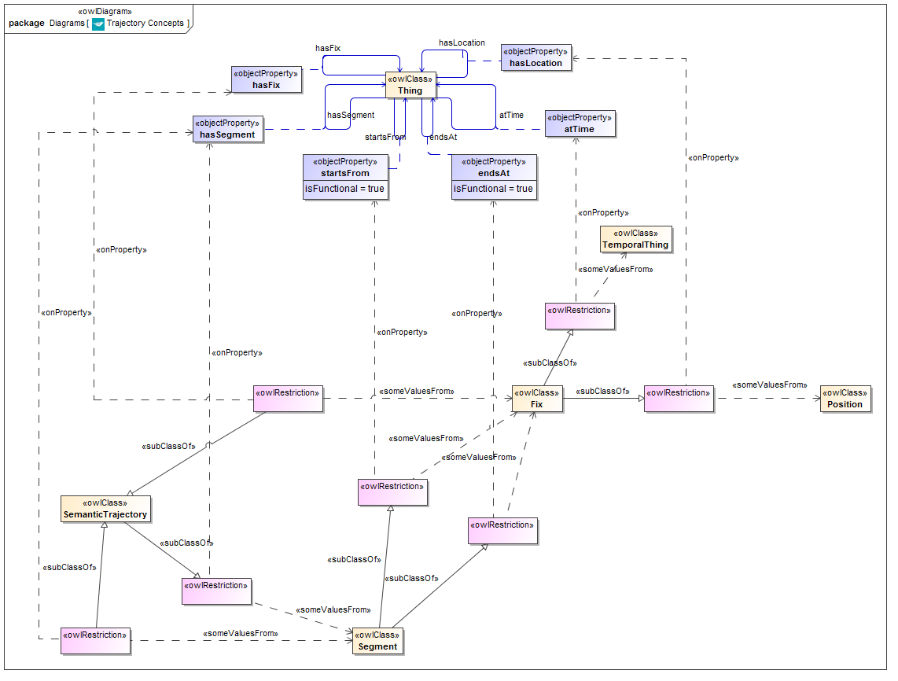
Example of 1: Trajectory Ontology

Slide 73
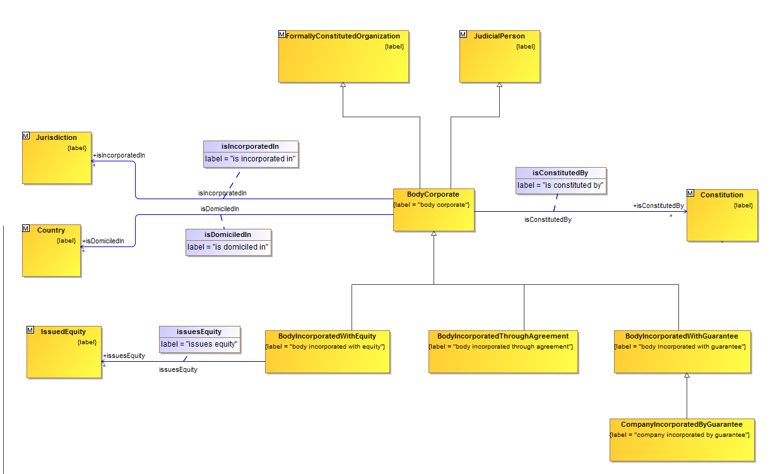
Example of 2: FIBO Body Corporate

Slide 74
Restriction versus Sub-property
Legacy FIBO:
  All properties unique
  By convention: property is necessary condition for class membership (unless min 0)
FIBO Refactoring Policy:
  Unique meaning: Make sub-property of more general property
  Not new meaning: Reuse existing property via restriction

Slide 75
Additional Restrictions
Formalize class membership via restriction on properties
  Existence of property does not mark out “necessary condition”
  Need rule on when to apply these on existing properties
Restriction “cascades” and patterns
  Need to identify patterns which work (via test)
  Also identify how to present business implications for the known good patterns

Slide 76
Formalizing Class Membership
Restrictions applied to a class:
  Necessary condition: subClassOf
  Necessary and sufficient condition: equivalentClass
Given semantically grounded properties, the logic in the restriction formally defines class intension (semantics)
  Need to identify which concepts ground the semantics in the model
Archetypical properties and classes

Slide 77
Restriction Combinations
Asserts semantics over and above legacy models
Test driven development for these
  Reasoner: ensure that things are not misclassified
  Business semantics: present business implications to SMEs for review

Slide 78
FIBO Business Conceptual Ontologies
Maintained in separate EDM Council namespace
OMG specifications are intended to provide rapid access to Semantic Web (inferencing) capabilities out of the box
EDM Council namespace represents the complete FIBO Business Conceptual Ontology
  This provides the full business semantics so that the application doesn’t have to
  Computationally independent i.e. unconstrained by application considerations

Slide 79
Additional OWL Features in OMG FIBO
Restrictions
“Cascaded” restrictions
Logical Unions
  Some of these replace what were complex restrictions on properties
Cascades of restrictions with unions
Annotation metadata
Ontology level and FIBO module metadata
Necessary v Necessary and Sufficient Conditions

Slide 80
FIBO BCO Conversion Plan
Identify which of the above features are appropriate for BCO
Identify how best to frame these
  E.g. known, validated patterns of restrictions
Important items to include:
  Restrictions
  Use of restrictions in framing Necessary versus Necessary and Sufficient conditions (and sufficient conditions?)
    Consider what classes to define in this sort of way
Named unions (named class + union + equivalency)

Slide 81
FIBO Legacy Content Overview
Language Models
Upper Ontology
FIBO Basic Business Ontologies
OMG FIBO Ontologies
Extensions to OMG Ontologies
(inverses etc.)
Future FIBO Ontologies

Slide 82
FIBO Legacy Content Namespaces
www.w3.org/2000/01/rdf-schema# ; www.w3.org/2002/07/owl# ; www.w3.org/2001/XMLSchema#
spec.edmcouncil.org/fibo/uo/
spec.edmcouncil.org/fibo/fnd/
spec.edmcouncil.org/fibo/v[n]/xxx/
Where XXX = domain namespace element
V[n] = major version number
Surrogate for published ontology URI which is:
www.omg.org/spec/EDMC-FIBO/XXX
fibo.edmcouncil.org/fibo/v[n]/xxx/
Where XXX = OMG Spec namespace element
V[n] = major version number
spec.edmcouncil.org/fibo/v[n]/xxx
www.omg.org/spec/EDMC-FIBO/XXX
Where XXX = OMG Spec namespace element
Elements excluded for OMG operational constraints would be included in extensions as before; Legacy OWL does not identify these

Slide 83
Legacy FIBO Disposition
Corporate Actions
Securities
Transactions
Dependency
Broader Framework: Process, Event, State
Pricing, Analytics
Securities and Derivatives Reference Data
Loans
Securitized v non Securitized Assets
Business Entity
Foundational Terms (Mid level ontology)
Accounting, Geo, Legal etc.
Core Concepts:
Time, Math, places and address etc.
Upper Ontology Lattice

Slide 84
Annex:
Deploying FIBO Ontologies

Slide 85
Using FIBO
EXTEND
Firm’s own Business Conceptual Ontology
DEPLOY
App
App
App

Slide 86
Actually…
EXTEND
Firm’s own Business Conceptual Ontology
DEPLOY
App
App
App

Slide 87

Deploying Extended BCO
Customer BCO
Adapters
DEPLOY
DEPLOY
Common Logical Data Model
Operational Ontologies
Operational Ontologies
Operational Ontologies
Local LDMs
Local LDMs

Slide 88
Reporting
!
Thing
Contract
IR Swap
CDS
Bond
Granular
data
Thing
Contract
IR Swap
CDS
Bond
Common
ontology
Common
ontology
REPORTING ENTITY
REGULATORY AUTHORITY
Data is mapped from each system of record into a common ontology
Reported as standardized, granular data
Agnostic to changes in forms
Receives standardized, granular data aligned with standard ontology (FIBO)
Uses semantic queries (SPARQL) to assemble information
Changes to forms need not require re-engineering by reporting entities

Slide 89
Annex: Use of Partitions in Legacy FIBO BCO
1: Independent Relative and Mediating Things
2: Continuant and Occurrent
3: Concrete and Abstract

Slide 90
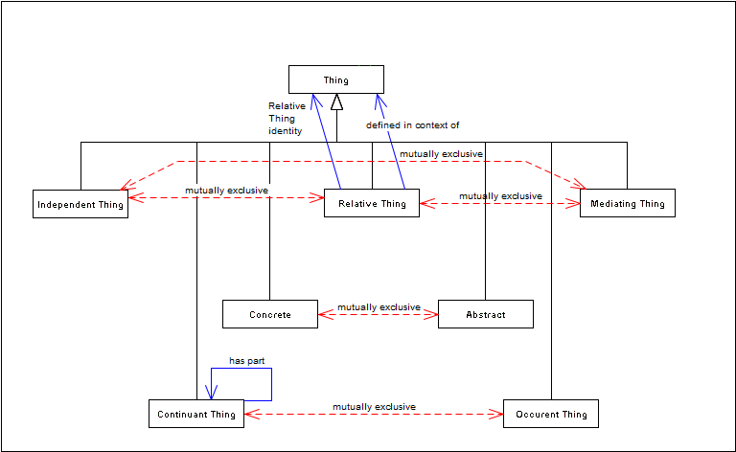
FIBO Upper Ontology Partitions

Slide 91
Ontology Partitioning 1
Everything which may be defined falls into one of three categories:
Thing
Independent Thing
Relative Thing
Mediating Thing
“Thing in Itself”
e.g. some Person
Thing in some context
e.g. that person as an employee, as a customer, as a pilot…
Context in which the relative things are defined
e.g. employment, sales, aviation
Notes:
“All that is in Heaven and Earth”
Anything which represents a meaningful business term, i.e. something which may have a label and a definition, falls under one of the following:
Independent
Relative
Mediating

Slide 92
Ontology Partitioning 1
Thing
Independent Thing
Relative Thing
Mediating Thing (context)
Person
Employee
Customer
Pilot
Employment
Sales
Aviation
“Has identity” relationship:
That which performs the
role of the “Relative Thing”

Slide 93
Ontology Partitioning 1
Thing
Independent Thing
Relative Thing
Mediating Thing (context)
Person
Employee
Customer
Pilot
Employment
Sales
Aviation
“In context of” relationship:
Context in which the Independent Thing
performs the role of the “Relative Thing”

Slide 94
Ontology Partitioning 1
Thing
Independent Thing
Relative Thing
Mediating Thing (context)
Person
Employee
Customer
Pilot
Employment
Sales
Aviation
“Has identity”
“In context of”
Everything which may be defined falls into one of these three categories
In order to complete a model of business terms and definitions, all three are needed
This extends beyond conventional ontology applications into a full and legally nuanced conceptual ontology
Notes:
This extends the use of ontology beyond mere physical, independent “Things” to everything which may be a term which the firm has to deal with and define
e.g. customer, counterparty, asset

Slide 95
Ontology Partitioning 2
Continuant and occurrent Things
Also known as Endurant and Perdurant
  Ref: Guarino and Welty

Slide 96
Ontology Partitioning 2
Thing
Continuant
Occurrent

Slide 97
Ontology Partitioning 2
Thing
Continuant
Occurrent
Continuant: where it exists it exists in all its parts
  Even if these change over time
Occurrent: the concept is only meaningful with reference to time

Slide 98
Ontology Partitioning 2
Thing
Continuant
Occurrent
Person
Contract
Pilot
Event
State
Etc.
Continuant: where it exists it exists in all its parts
  Even if these change over time
Occurrent: the concept is only meaningful with reference to time

Slide 99
Ontology Partitioning 2
Thing
Continuant
Occurrent
Person
Contract
Pilot
Event
State
Etc.
Things which are independent or relative are also either continuant or occurrent

Slide 100
Ontology Partitioning 2 Example
Thing
Continuant
Occurrent
Me
My life
Me: where I exist I exist in all my parts
  Even if these change over time
My life: happens over a period of time and cannot be defined without time

Slide 101
Ontology Partitioning 3
Thing
Concrete
Abstract

Slide 102
Ontology Partitioning 3
Thing
Concrete
Abstract
Concrete: A physical thing
  Or a virtual thing in some reality
Abstract: the concept is only meaningful as an abstraction from reality

Slide 103
Ontology Partitioning 3
Thing
Concrete
Abstract
Pillar of Stone
Financial Instrument
Goal
Resolution
Desire
Wheelbarrow
Not as simple as physical v non physical
Concrete: not limited to physical reality
  Demateralized securities
Abstract: no physical or virtual expression

Slide 104
Partitioning Research Agenda
Existing partitions are top layer of Sowa KR Lattice ontology
  Subsequent layers of KR Lattice ignored
Certain concepts e.g. “Information” do not seem to fit so neatly
Also introduced a “Platonic” distinction
  Distinguishes certain things from expressions of those things e.g. Price v Price specification
Need to review COLORE, BFO, DOLCE etc.

