Slide 1
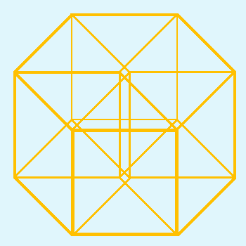
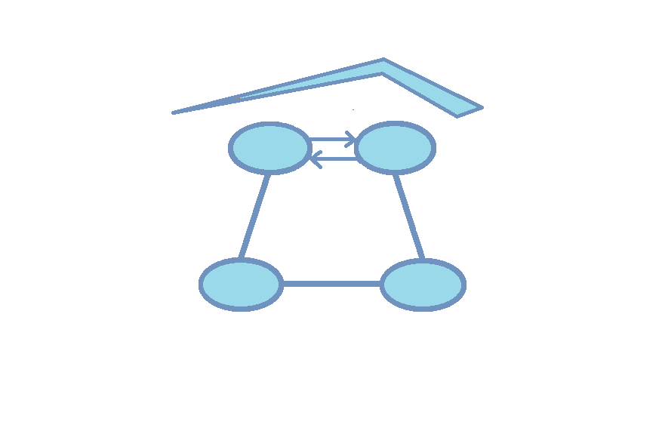

Concept Modeling in the Real World
Hypercube Ltd.
Mike Bennett
Hypercube Ltd.

Slide 2
Overview
Most organizations have disconnected systems of people, processes, and information.
Concept models of the real world can help.
Cameo Concept Modeler (CCM) harmonizes concept models and systems engineering.
This tutorial is aimed at business analysts, ontologists and others with an interest in formal concept modeling.
The tutorial gives a basic grounding in concept modeling with hands-on illustrations of common concept modeling techniques and solutions to common data integration problems that these can address.

Slide 3
Agenda
Introduction
Restrictions
Classification
Conceptual Issues
Ontological Techniques
Introducing Data
Implementation

Slide 4
Introduction

Slide 5
What’s This?

Slide 6
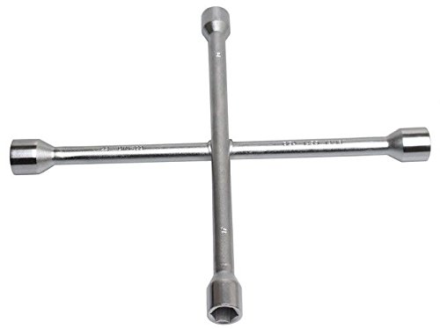
Radcreuz

Slide 7
Concepts not Words
I know what a radcreuz is (I bought it)
I never found and English word for it
  I never needed to
  Actually there isn’t one
  Only qualified names for more general categories of wheel wrench
I did not need the word to change a wheel

Slide 8
Why Concept Modeling?
“You can use an eraser on the drawing board or a sledgehammer on the construction site”
  - Frank Lloyd Wright

Slide 9
Concepts
In this Tutorial we will be focusing on concepts
  Not words
  Not data elements, field names etc.
We will also learn how to frame concepts in ways that are :
  Unambiguous for communication among people
  Interpretable my machines
From a principled model of concepts we can achieve
  Model driven development
  Integration of data sources
  Business communications and reporting

Slide 10
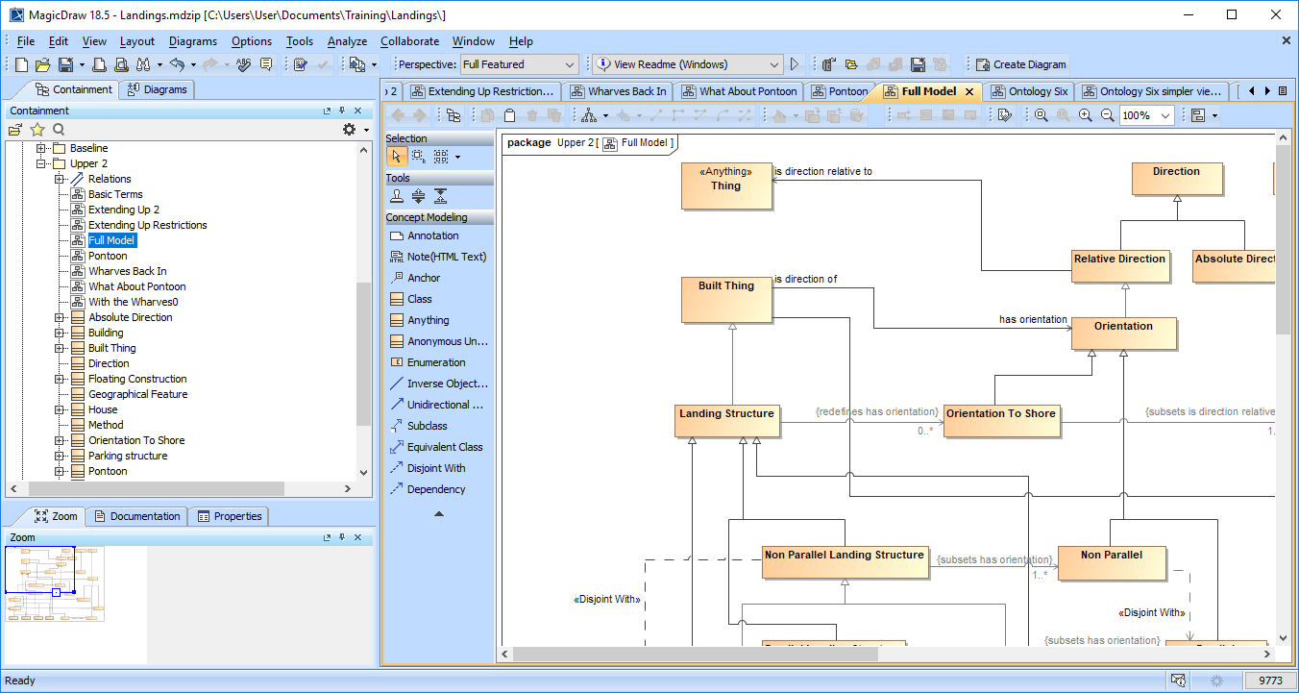
Introducing Cameo Concept Modeler

Slide 11
Introducing Cameo Concept Modeler
Concept
modeling
toolbar

Slide 12
A Progression
We invented words to standardize concepts
We invented dictionaries to standardize words
We invented ontologies to standardize concepts

Slide 13
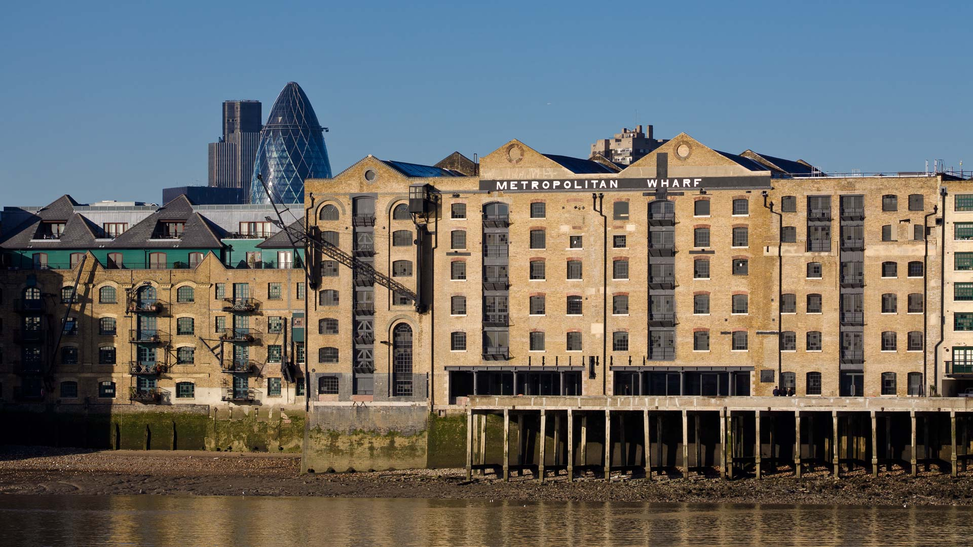


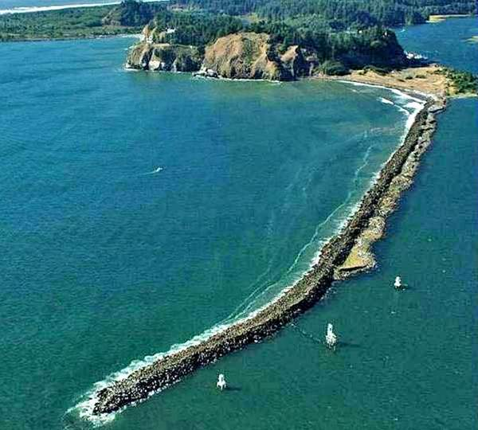
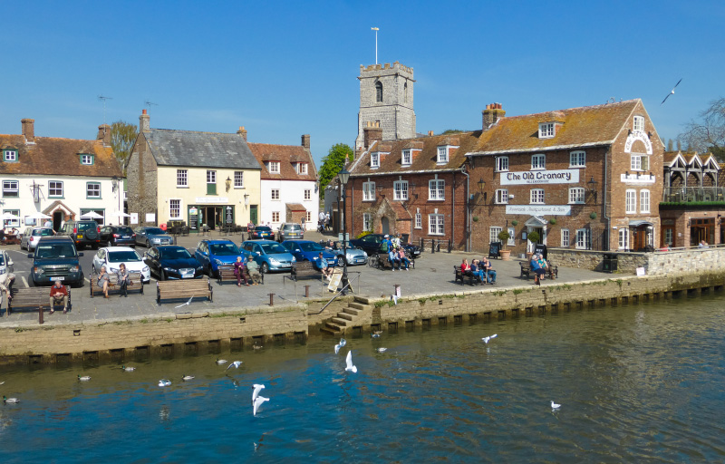

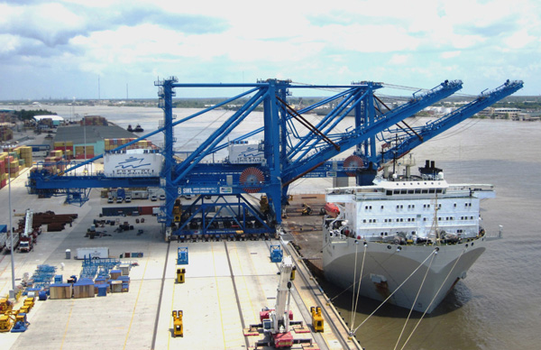
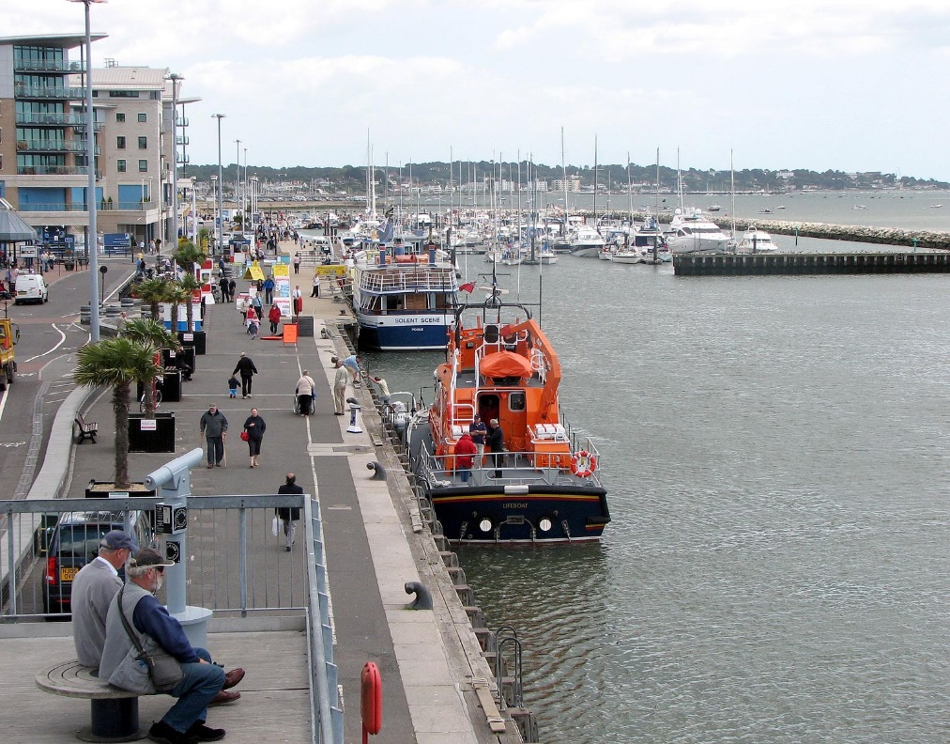
Some Things

Slide 14

Wharves, Jetties, Piers and Quays
Wharf
Quay
Jetty
Pier

Slide 15
Wharves, Jetties, Piers and Quays
A wharf is a platform by a river or the sea where ships can be tied up.
A jetty is a wide stone wall or wooden platform where boats stop to let people get on or off, or to load or unload goods.
A pier is a platform sticking out into water, usually the sea, which people walk along or use when getting onto or off boats.
A quay is a long platform beside the sea or a river where boats can be tied up and loaded or unloaded.

Slide 16
Wharves, Jetties, Piers and Quays
Did you know…
Wharf
  Parallel
  Open
Jetty
  Perpendicular
  Solid
Pier
  Perpendicular
  Open
Quay
  Parallel
  Solid

Slide 17
Wharves, Jetties, Piers and Quays Truth Table
Solid Construction
Open Construction
Is parallel to shore
Quay
Wharf
Is not parallel to shore
Jetty
Pier

Slide 18
Wharves, Jetties, Piers and Quays Venn Diagram
Things that are
solidly made
Things that are
open
Things that are
parallel to shore
Quay
Wharf
Things that are
Not parallel to shore
Jetty
Pier

Slide 19
Modified Venn Diagram
Things that are
solidly made
Things that are
open
Things that are
parallel to shore
Quay
Wharf
Things that are
not parallel to shore
Jetty
Pier
Still a Venn Diagram but there are no odd spaces

Slide 20
Landing Places Venn Diagram
Things that are
solidly made
Things that are
open
Things that are
parallel to shore
Quay
Wharf
Things where you
can land a boat
Things that are
Not parallel to shore
Jetty
Pier

Slide 21
Modified Venn Diagram
Things where you
can land a boat
Things that are
solidly made
Things that are
open
Things that are
parallel to shore
Quay
Wharf
Things that are
not parallel to shore
Jetty
Pier

Slide 22
Premise
We are enhancing a dictionary by creating definitions that are underpinned with logic
In so doing we are teasing out more coherent concepts
These cover the same semantic space as the words (the words give the scope of the exercise)
These more precise meanings DO NOT cover all the meanings of that word, even in that context (e.g. Jetty in a lake)

Slide 23
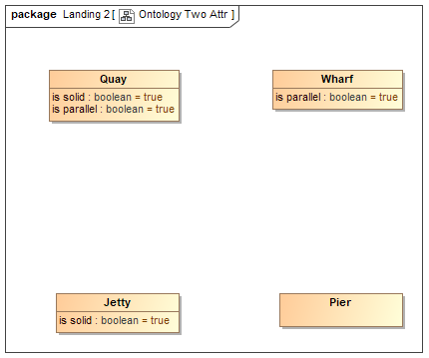
Basic Assertions
These don’t really work as you can’t assert default values for the Boolean in OWL/FOL
Just imagine we could for the moment…

Slide 24
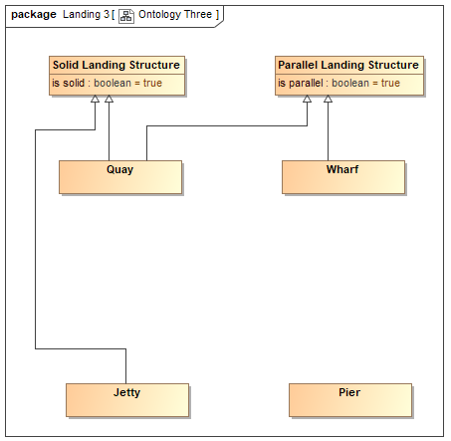
Abstracting the Assertions

Slide 25
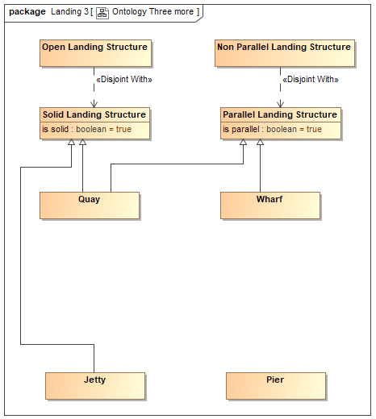
Abstracting the Assertions

Slide 26
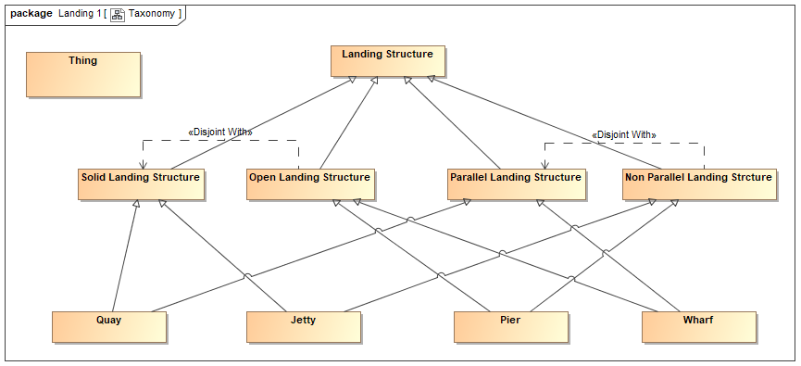
Taxonomy

Slide 27
Some Observations on Abstraction
Working with subject matter experts requires careful management of the knowledge acquisition process
Pitfalls:
  Silo-based assumptions
  Localized jargon
  Reliance on words
Make sure SMEs fully understand the “set theoretic” nature of the presentation materials
Make sure they understand synonyms, heteronyms
Make sure they are aware of any ontological abstractions or “buckets” you may have in the ontology (these will not correspond to anything in the SMEs’ own experience!)

Slide 28
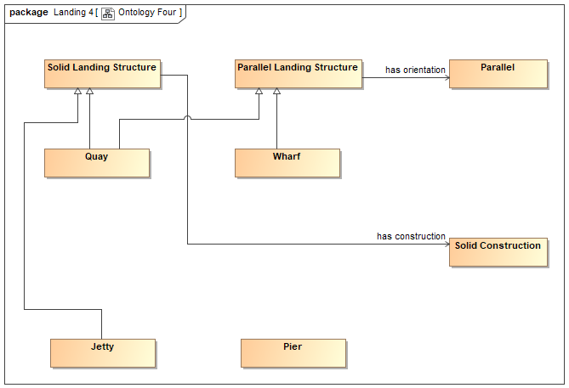
Introducing Properties

Slide 29
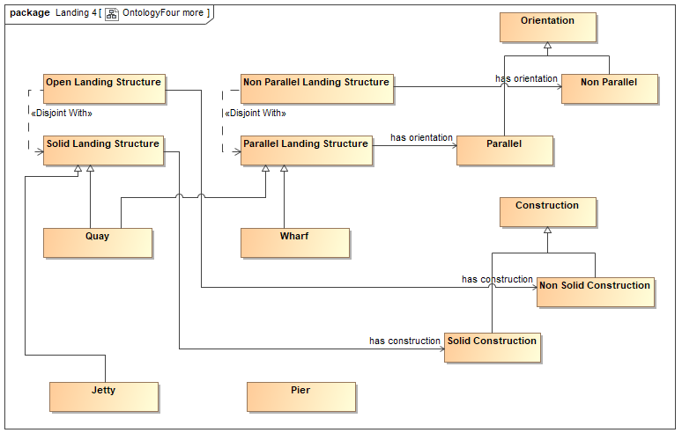
Abstracting Property Ranges

Slide 30
Abstraction
How to abstract concepts
Top down versus bottom up
Where to stop?
Use of use cases
Not everyone is comfortable with abstractions
This is where you really have to think about meaning
Also where you need to facilitate SME review input carefully

Slide 31
Making it Meaningful
Putting something into RDF/OWL does not make it meaningful
  Only you can do that
So, what is a meaningful model
  1. Formal relationship between model and subject matter:
    “Everything is a Thing”
  2. Formal notation grounded in common logic
  3. Abstraction of kinds of thing into their simplest possible building blocks
    Contracts, Parties, Legal Entities etc.

Slide 32
Formal Logic
Ontology models rely on two logic constructs from formal logic
  Universal Quantifier : “For all”
  Existential Qualifier : “There exists”
These make up the “First Order Logic”
Allows you to define Things and Facts
  Things: sets of which something may be a member
  Facts: properties which intensionally define membership of that set
  Can also describe sets extensionally

Slide 33
Formal Logic
Lets us assert the existence of things
Lets us state, for given things, facts about them
  These are properties
  How it looks:
You would not want to present these to business subject matter experts!

Slide 34
Applying this to Domain Semantics
Everything is a Thing
  What kind of Thing?
  What distinguishes it from other things?
What kind of Thing?
  Share is a Security is a Transferable Contract … is a Contract
What properties?
  Share gives the holder some Equity
  Share confers on the holder some Voting Rights

Slide 35
The Two ontological Questions
For each kind of “Thing” in the ontology (each class):
  What kind of thing is this?
  What distinguishes it from other things?

Slide 36
Defining a Kind of Thing
We start with some kind of thing
Some kind of thing

Slide 37
Defining a Kind of Thing
We ask just two questions about this kind of thing:
  What kind of thing is it?
  What distinguishes it from other things?
Some kind of thing

Slide 38
What kind of thing is it?
Animal
Vertebrate
Invertebrate
Bird
Mammal
Fish
Waterfowl
Some kind of thing

Slide 39
What distinguishes it from other things?
Animal
Vertebrate
Invertebrate
Bird
Mammal
Fish
Waterfowl
Walks like a duck
Some kind of thing
Swims like a duck
Quacks like a duck

Slide 40
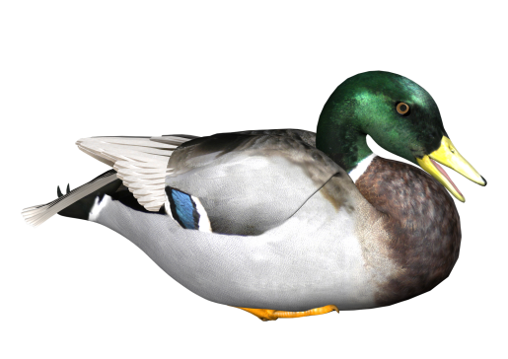
It’s a Duck!
Animal
Vertebrate
Invertebrate
Bird
Mammal
Fish
Waterfowl
Walks like a duck
Swims like a duck
Quacks like a duck

Slide 41
Theory of Meaning – in English
The model consists of:
  Things
    A Thing is a set theory construct
    Arranged in a hierarchy called a “Taxonomy”
      Like taxonomy of species
  Facts
    Simple facts (names, dates etc.)
      e.g. “Issue Date” is a date
    Relationship Facts (relate one thing to another thing)
      e.g. “Share confers Voting Rights”
      Things so referenced are also in taxonomic hierarchies
  Other set theory concepts
    Disjoints, Unions

Slide 42
Theory of Meaning – in English
Taxonomy: Like Taxonomy of Species
  Animal v Plant
  Vertebrate v invertebrate
  Mammals, fish etc.
Each thing is defined by what facts distinguish it
For each new thing:
  What sort of thing is it?
  What facts distinguish it from other things?
If it walks like a duck, swims like a duck and quacks like a duck, it belongs to the set of all things that are a duck

Slide 43
Abstract Thinking
What kind of “Thing” is …
  An address?
    An address is an index to a location
  A client? A customer?
    Related to a product / service or to a whole business?
  A securities exchange?
    How does it differ from a street market?
    What does an exchange have in common with a street market?
    Where does the classification hierarchy (taxonomy) divide?

Slide 44
Abstract Thinking
What kind of “Thing” is …
  An address?
    An address is an index to a location
  A client? A customer?
    Related to a product / service or to a whole business?
  A securities exchange?
    How does it differ from a street market?
    What does an exchange have in common with a street market?
    Where does the classification hierarchy (taxonomy) divide?

Slide 45
Logical Restrictions

Slide 46
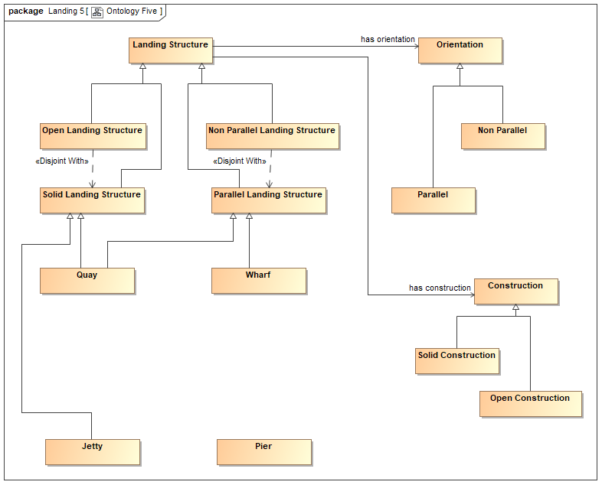
Introducing Restrictions

Slide 47
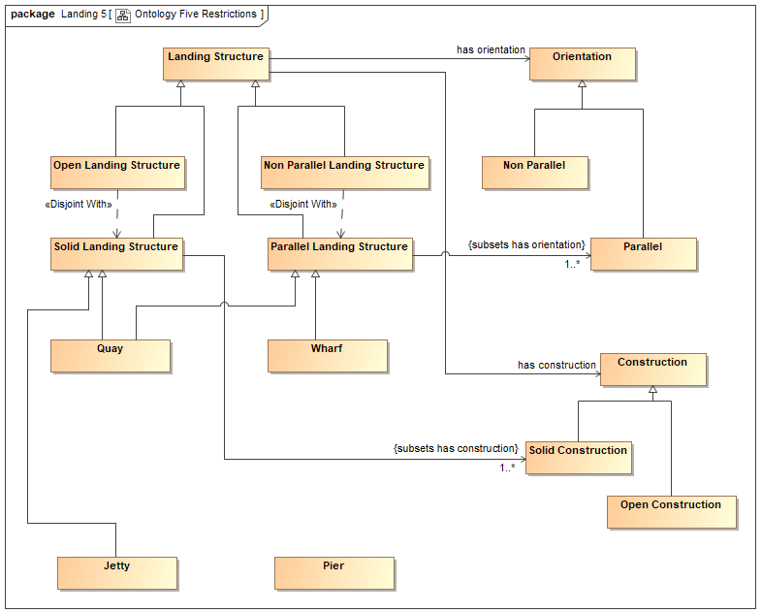
Introducing Restrictions

Slide 48
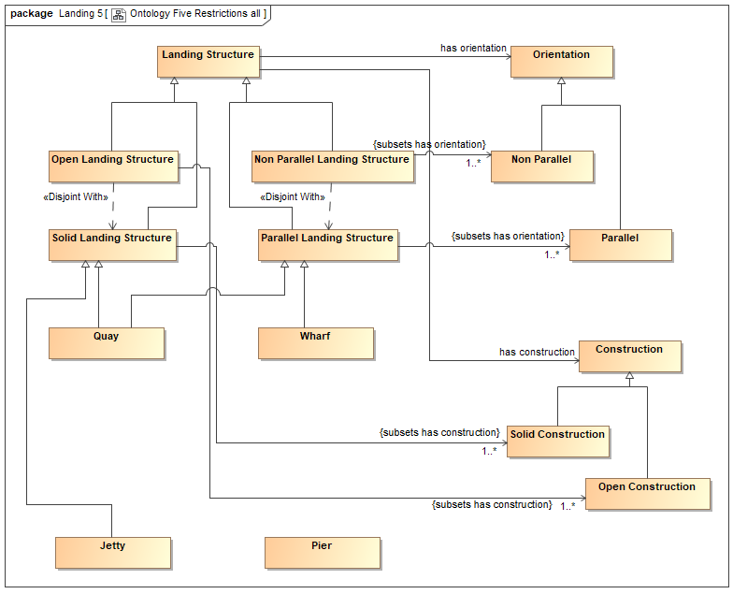
Introducing Restrictions

Slide 49
What is a Restriction?
Restriction

Slide 50
What is a Restriction?
  A restriction is a set of things just like a class
  It is the set of all things which there are which have the property as restricted…
Restriction

Slide 51
What is a Restriction?
  There are three kinds of restriction
Restriction

Slide 52
What is a Restriction?
  There are three kinds of restriction
  And two ways in which a restriction may be applied
    Actually three…
Restriction

Slide 53
What is a Restriction?
  Restriction is applied to some property
uxoriates
On property
Restriction

Slide 54
What is a Restriction?
  There are three kinds of restriction
    1. All values from
  This is the set of all things having the property, where the target (range) of that property may only be the designated class
uxoriates
On property
may only be
Some Thing
Restriction
OWL: allValuesFrom

Slide 55
What is a Restriction?
  There are three kinds of restriction
    2. Some values from
  This is the set of all things having the property, where at least some of the occurrences of that property must have as their target (range), something from the designated class
uxoriates
On property
must be some
Some Thing
Restriction
OWL: someValuesFrom

Slide 56
What is a Restriction?
  There are three kinds of restriction
    3. Cardinality Restriction
  This is the set of all things having the property, where occurrences of that property must have as their target (range), the multiplicity (cardinality) shown, from the designated class
    If no class is given, the multiplicity applies to the unrestricted range
uxoriates
On property
taken from
Some Thing
Restriction
Min=1
OWL: onClass

Slide 57
What is a Restriction?
    1. Necessary Condition
  There are two ways of applying a restriction
  Your Thing is a member of the set of all things which have the property as restricted
  This means that the restriction is a necessary condition for membership of Your Thing
Restriction
OWL: subClassOf
Your Thing

Slide 58
What is a Restriction?
    1. Sufficient Condition
  There are two ways of applying a restriction
  Your Thing is equivalent to the set of all things which have the property as restricted
  This means that the restriction is a necessary and sufficient condition for membership of Your Class (everything in the restriction is in Your Thing and vice versa)
Restriction
OWL: equivalentClass
Your Thing

Slide 59
What is a Restriction?
    3. As range of another restriction
  There are actually three ways of applying a restriction:
  In this case the allowable range of the restricted property is itself another restriction
  Use with caution; parse with care and test with test data!!
Restriction
Restriction
all values from / some values from / on class

Slide 60
CCM Restrictions Cheat Sheet
Association End | Multiplicity | OWL | Meaning
propertyName {subsets otherPropertyName} | None | propertyName subPropertyOf otherpropertyName | Sub property
Blank {subsets propertyName) | 1..* | someValuesFrom | Must be some
Blank {redefines propertyName) | 0..* | allValuesFrom restriction | May only be
Blank {subsets propertyName) | m..n | Min m Cardinality restriction Max n Cardinality Restriction | m..n values of property

Slide 61
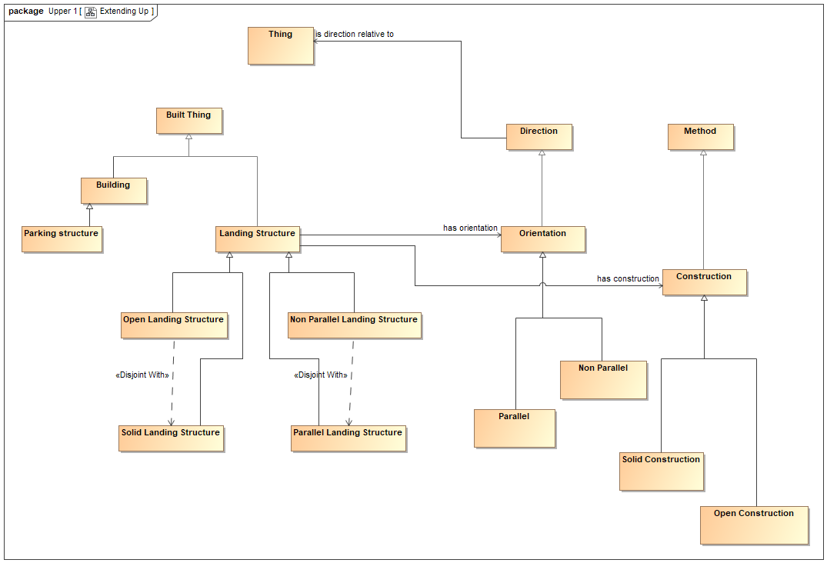
Extending Upward

Slide 62
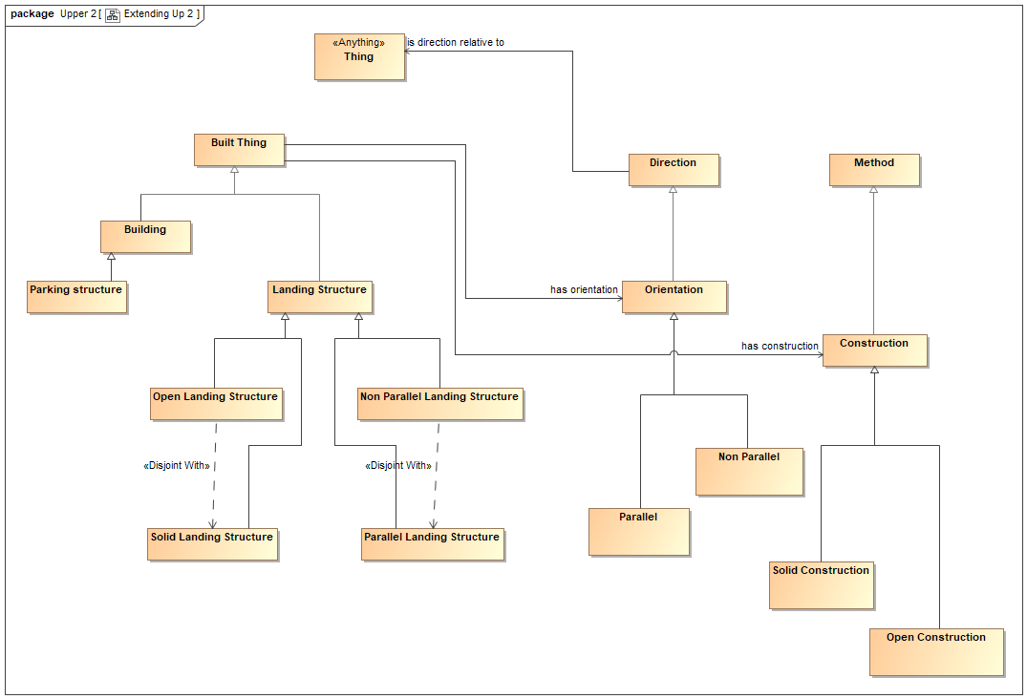
Extending Upward

Slide 63
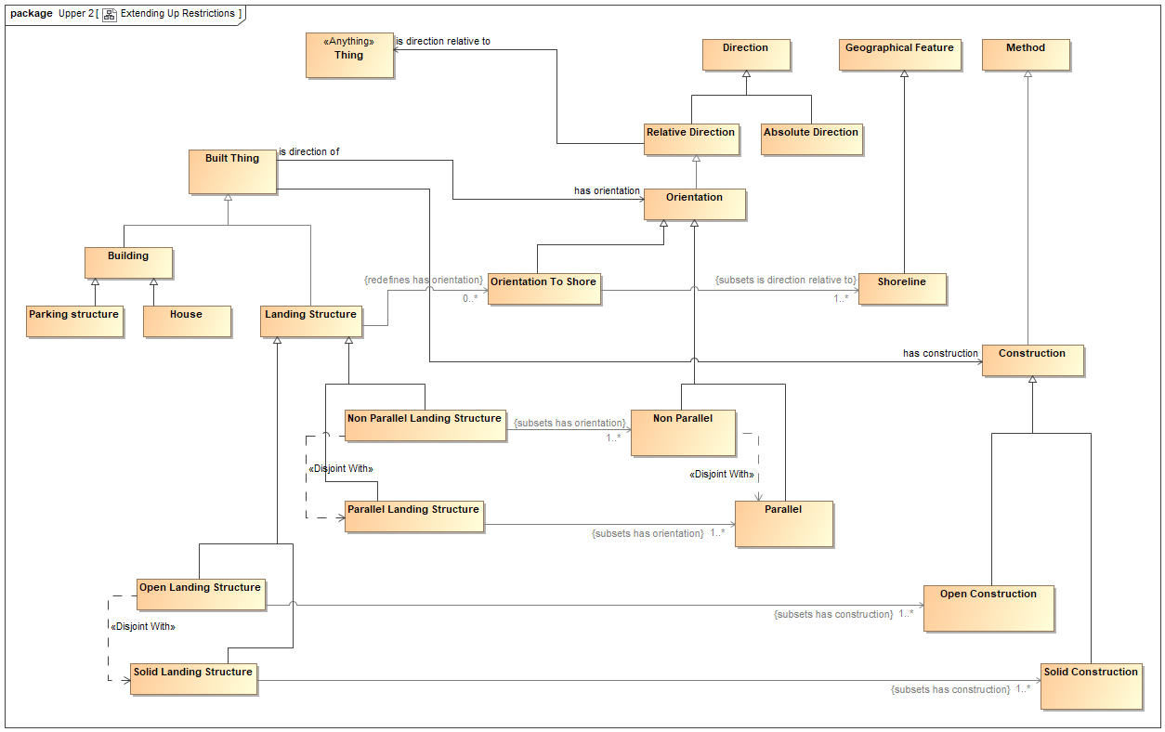
Extending and Refining Some More

Slide 64
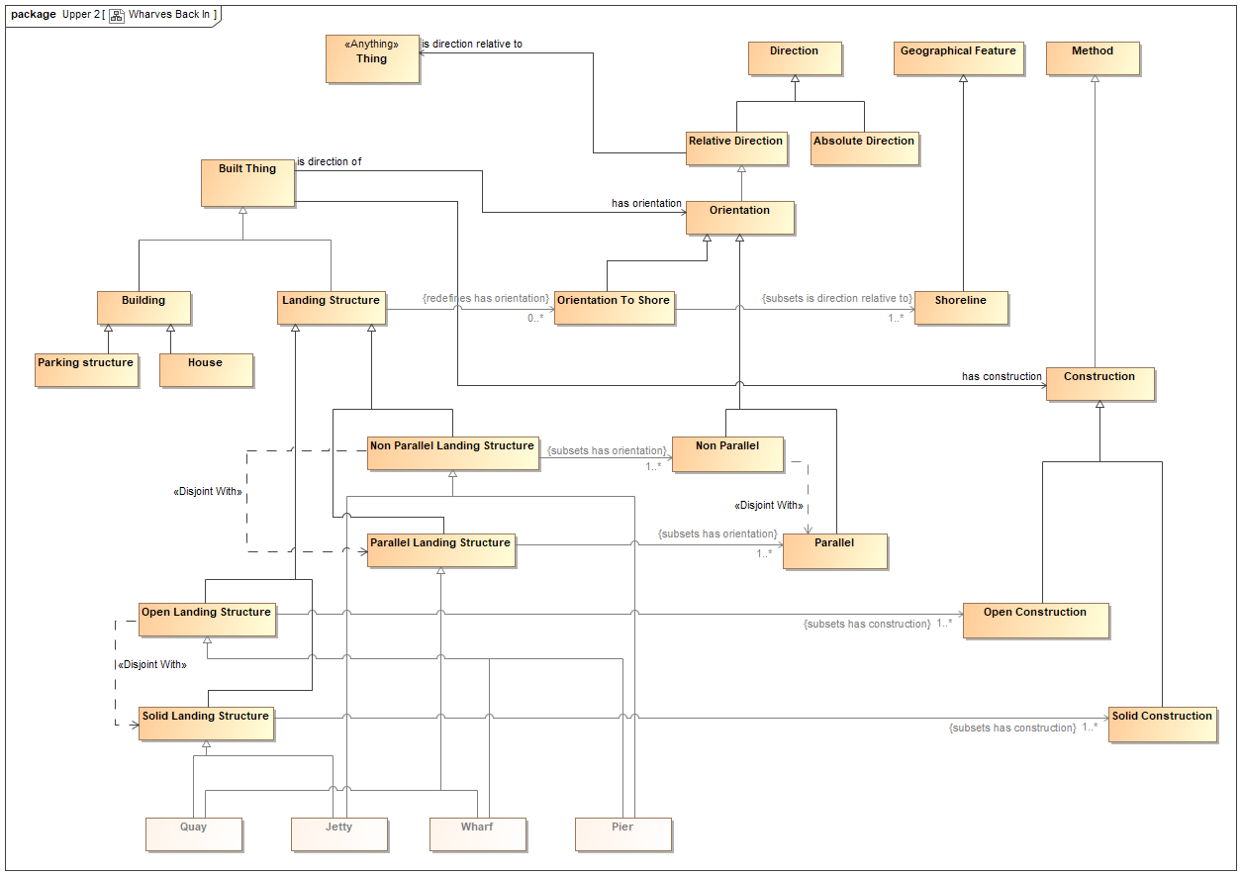
Putting the Wharves Back In

Slide 65
Concept Grounding
Concepts include:
  To land something
  A purpose
  Construction method and abstraction to Open v Closed
    Definition doesn’t care if it is rock, brick or concrete
  Orientation relative to something else)
  Features (bollards etc.)
  Fees
  Capacities and capabilities (can I unload this thing here?)
    Physical – based on shape, size material
    Legal and social – what is allowed?

Slide 66
Landing Places Venn Diagram
Things that are
solidly made
Things that are
open
Things that are
parallel to shore
Quay
Wharf
Things where you
can land a boat
Things that are
Not parallel to shore
Jetty
Pier

Slide 67
Modified Venn Diagram
Things where you
can land a boat
Things that are
solidly made
Things that are
open
Things that are
parallel to shore
Quay
Wharf
Things that are
not parallel to shore
Jetty
Pier

Slide 68
But are these all the Things?
For a give class of things, the sub-classes may:
  Be disjoint: a member of any one is not a member of the others
  Be complete: all the members of the parent class are somewhere among the sub-classes
Given our class of Landing Facility, have we identified all 4?
What about pontoons?

Slide 69
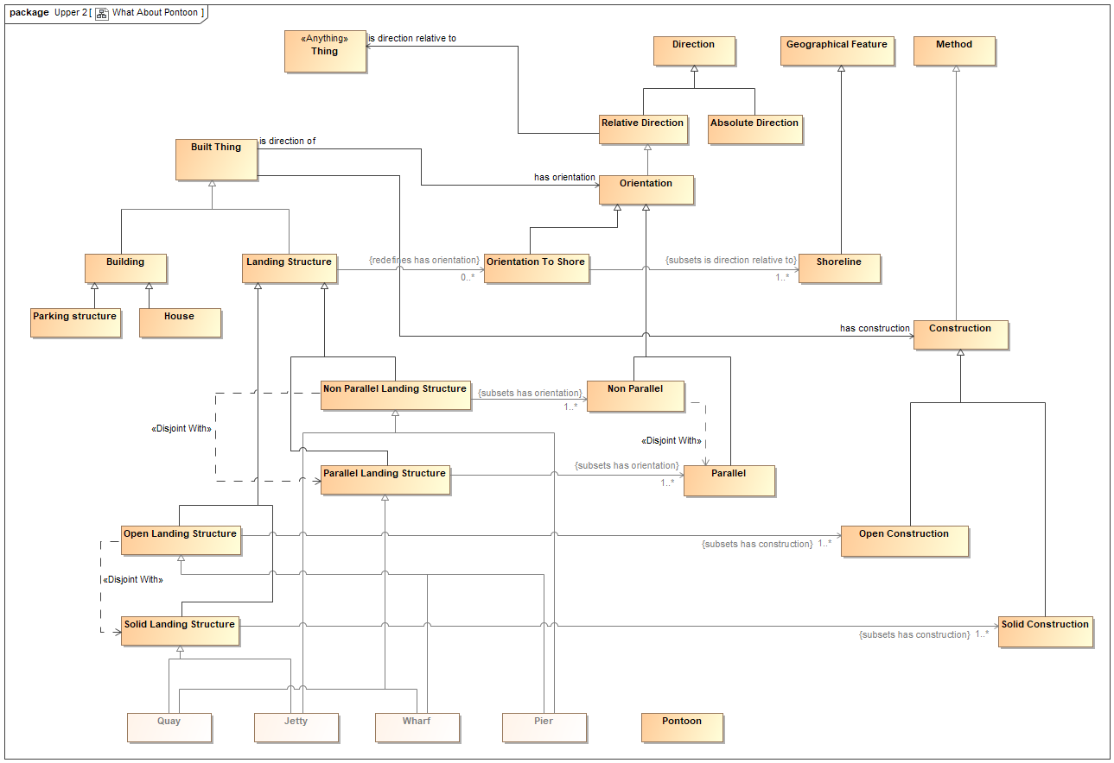
What About Pontoon?
?

Slide 70
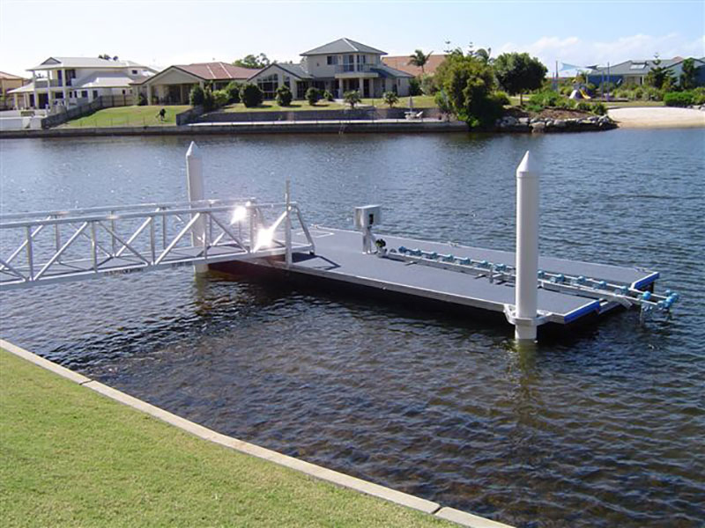
Pontoons

Slide 71
Pontoon
One of those is a heteronym
The one we are interested in can also serve as a landing stage
In the Venn Diagram:
  It is a third construction
  It does not care if it is parallel or perpendicular
Meanwhile:
  Pontoon (1) can be used as a landing

Slide 72
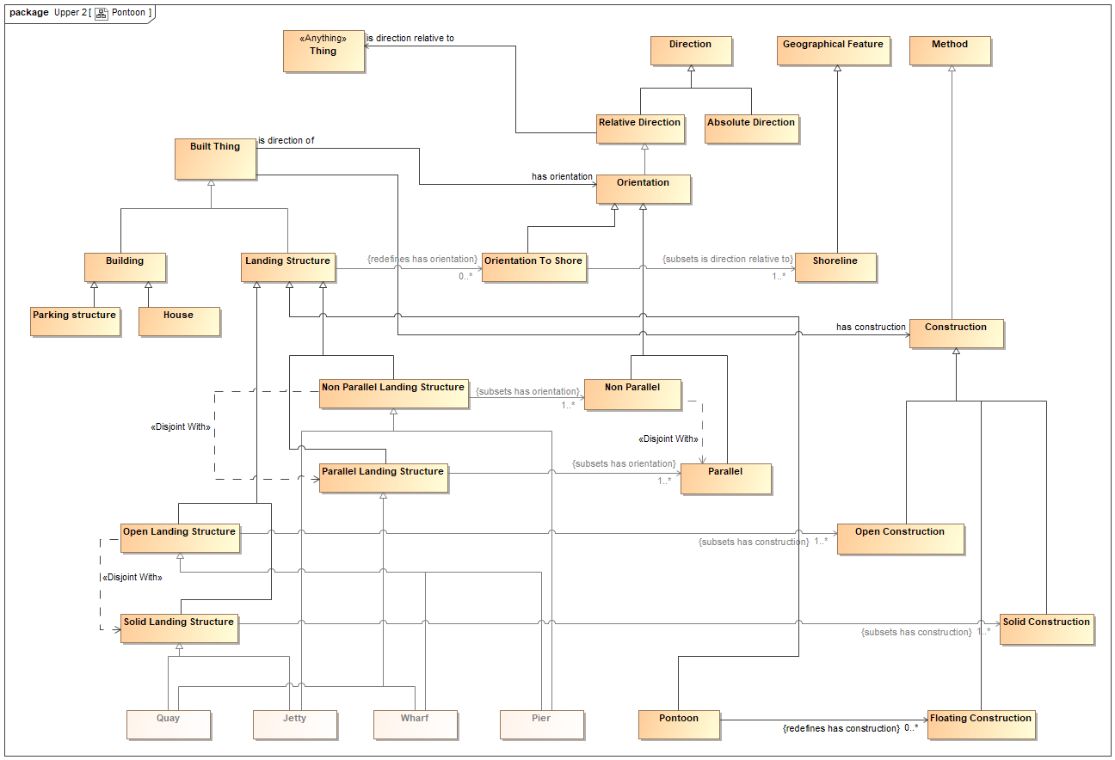
Pontoons

Slide 73
Modified Venn Diagram with Pontoon
Things where you
can land a boat
Things that are
solidly made
Things that are
open
Things that float
Things that are
parallel to shore
Quay
Wharf
Pontoon
Things not
parallel to shore
Jetty
Pier

Slide 74
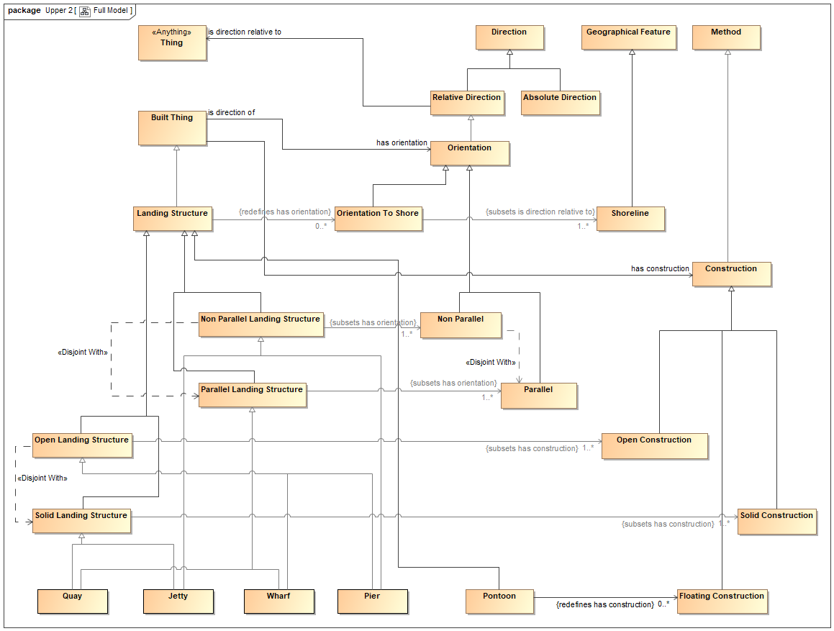
Full view so Far

Slide 75
Pontoons
Ontology has evolved
Changes were additive
Premise:
  Ontology should always be extensible
Caveats:
  This won’t work if you have not abstracted adequately (brittle like a data model)
  You can interpose further abstractions later (generalizations can bypass classes

Slide 76
Classification Principles

Slide 77
Sets of sub-sets
In UML: Generalization Sets
  Also in UML Concept Modeling Profile (CCM)
These may be:
  Complete and disjoint
  Complete and overlapping
  Incomplete and disjoint
  Incomplete and overlapping

Slide 78
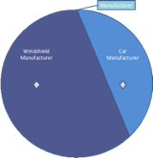
Complete and Disjoint
UML Concept Modeling Profile
Draft Specification
OMG Document Number: ad/2018-08-01

Slide 79
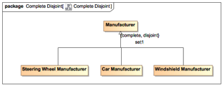
Complete and Disjoint
Manufacturer ≡ 'Steering Wheel Manufacturer' ⊔ 'Car Manufacturer' ⊔ 'Windshield Manufacturer'
'Steering Wheel Manufacturer' ⊑ ¬ 'Car Manufacturer' ⊓ ¬ 'Windshield Manufacturer'
Car Manufacturer' ⊑ ¬ 'Windshield Manufacturer'
UML Concept Modeling Profile
Draft Specification
OMG Document Number: ad/2018-08-01

Slide 80
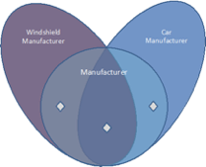
Complete and Overlapping
UML Concept Modeling Profile
Draft Specification
OMG Document Number: ad/2018-08-01

Slide 81
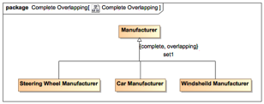
Complete and Overlapping
Manufacturer ≡ 'Steering Wheel Manufacturer' ⊔ 'Car Manufacturer' ⊔ 'Windshield Manufacturer'
UML Concept Modeling Profile
Draft Specification
OMG Document Number: ad/2018-08-01

Slide 82
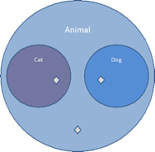
Incomplete and disjoint
UML Concept Modeling Profile
Draft Specification
OMG Document Number: ad/2018-08-01

Slide 83
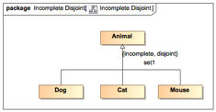
Incomplete and disjoint
Dog ⊑ Animal ⊓ ¬Cat ⊓ ¬Mouse
Cat ⊑ Animal ⊓ ¬Mouse
Mouse ⊑ Animal
UML Concept Modeling Profile
Draft Specification
OMG Document Number: ad/2018-08-01

Slide 84
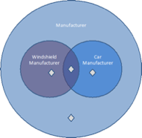
Incomplete and overlapping
UML Concept Modeling Profile
Draft Specification
OMG Document Number: ad/2018-08-01

Slide 85
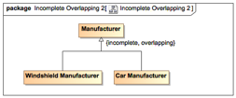
Incomplete and overlapping
'Windshield Manufacturer' ⊑ Manufacturer
'Car Manufacturer' ⊑ Manufacturer
UML Concept Modeling Profile
Draft Specification
OMG Document Number: ad/2018-08-01

Slide 86
Faceted Classification
Single multiple (polyhierarchical) classification
Facets by which to classify things
Using facets
Facets and powertypes

Slide 87
A faceted scheme…
A: Shape
Circle
Triangle
Square
B: Size
Small
Medium
Large
C: Color
Green
Red
Yellow

Slide 88
Facets are “clearly defined, mutually exclusive, and collectively exhaustive aspects, properties, or characteristics of a class or specific subject.” – Taylor, 1992

Slide 89
Classification and Abstraction
Thing

Slide 90
Classification and Abstraction
Thing
Red Thing
Blue Thing
Differentiae: what distinguishes the sub types of the Thing

Slide 91
Classification and Abstraction
Thing
Round Thing
Square Thing
Differentiae: what distinguishes the sub types of the Thing

Slide 92
Faceted Classification
Thing
Red Thing
Blue Thing
Round Thing
Square Thing
Round Red Thing
Round Blue Thing
etc.

Slide 93
Recommendations
When use a hierarchy
  If possible, one relationship type should dominate: generic hierarchical relationships
  Allow polyhierarchies
  Supplement with associative (or other relationship types) when appropriate
  Consider facet analysis when dealing with fairly homogeneous items

Slide 94
Classification Principles
Use of subClassOf as the differentiating relationship
Classify subject matter according to differentiae
  What distinguishes this thing from another thing
  That is, addition of or variation to properties of the parent class
    Addition: hasBackbone for vertebrates
    Variation: mortgage original maturity
Faceted classification
  Use of multiple differentiae for one parent class

Slide 95
Dealing with CFs
Once facets are recognized and documented they may be used in one of two ways:
  Monohierchy: place the facets in a consistent order
  Polyhierarchy: put the facets side by side in the ontology
Use monohierarchy only if a single unique set of leaf nodes is needed e.g. for stacking books, allocating unique IDs
Use polyhierarchy in an ontology
  E.g. IR Swap is both an IR derivative and a swap

Slide 96
Powertypes
Origin is the Powerset (mathematics)
Powertypes are conceptual
Used for punning
  When you need an instance that is lo a class
Comparison with Classification Facets

Slide 97
Powertypes Summary
Powertypes, like Relative Things, are always there in the conceptual space
  As with Relative Things, these only need to be surfaced in a specific design ontology if there is a need for that concept to be surfaced and have clear defining characteristics in the data and the model
Powertype also have a relationship to our conceptual ‘Classification Facets’
  E.g. for swaps, for equity and so on
  Can replace with Powertypes
Powertypes being represented by Classification Facets, also correspond to UML GenSet conceptualizations
All Powertypes are Classification facets
Not all Classification Facets are used as Powertypes
Stand up a Powertype IFF:
  The data itself stands for a category of things in the world
  E.g.: Tree species, product calalog entries

Slide 98
Punning
Not every facet or partition will also require punning (individuals as categories) but many will
  Product types
  Species e.g. of tree, car etc.
  Process definitions versus process occurrences (we currently use a separate partitioning approach for these).
Some are just Powertypes but not OWL punning requirements
Others will need OWL punning
Usage:
  If the data instances (individuals) stand in for categories of thin in the workd, model as a powertype
  E.g. catalog entry, species

Slide 99
Conceptual Issues

Slide 100
Conceptual Issues
Words are not Concepts
Syntax is not Semantics
Meaning is not Truth

Slide 101
Concepts and Words
Glossaries etc.
Choice of labels
Meanings without Words - The Mombe problem

Slide 102
The FIBO Moment
The realization that, while people could argue forever about terms (words), they can easily agree on concepts as long as they can use different synonyms for them

Slide 103
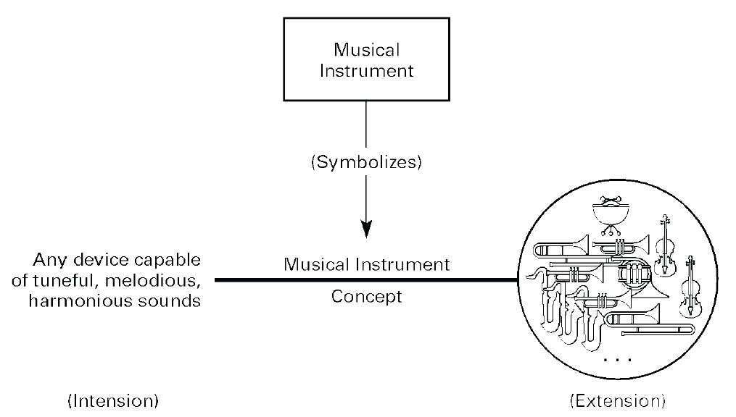
Anatomy of Concept
Diagram: Jim Odell

Slide 104
Intension and Extension
Concept
Extends
Intension
Extension
Intends
Extension of a concept may happen one, many or no times

Slide 105
The Semiotic Triangle (Peirce)
Concepts
Signs
Real World Objects

Slide 106
The Semiotic Rhombus
Concepts
Intensions
Extensions
Signs
Real World Objects

Slide 107
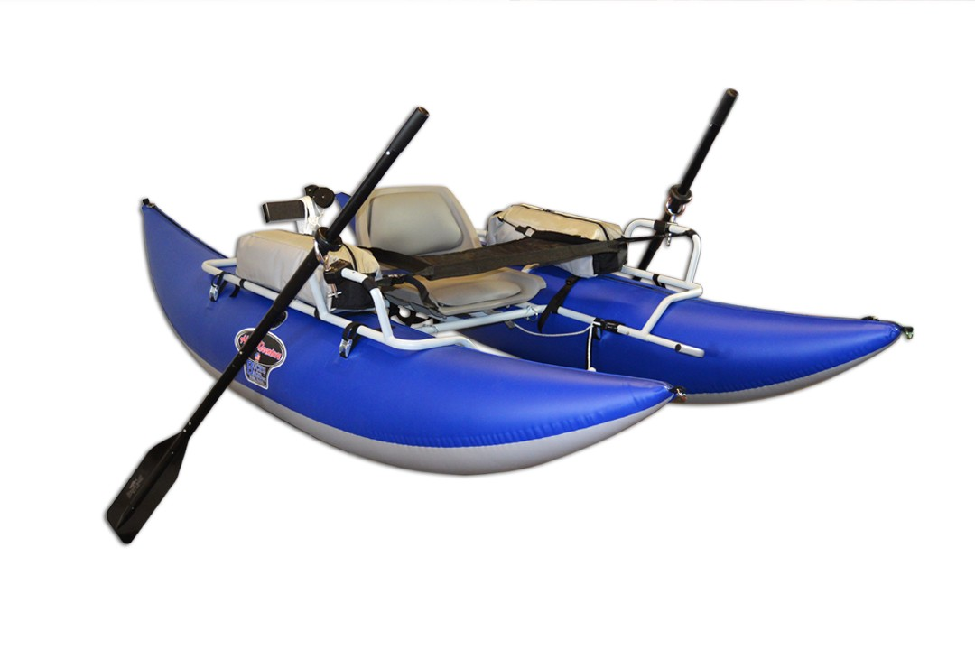
Pontoons (disambiguation)
Pontoon
(a kind of landing stage, that floats)
Pontoon
(of catamaran or multi-hull)

Slide 108
Let’s Revisit the Words and Definitions
A wharf is a platform by a river or the sea where ships can be tied up.
A jetty is a wide stone wall or wooden platform where boats stop to let people get on or off, or to load or unload goods.
A pier is a platform sticking out into water, usually the sea, which people walk along or use when getting onto or off boats.
A quay is a long platform beside the sea or a river where boats can be tied up and loaded or unloaded.

Slide 109
Definitions
Under-specified
  The Ontological approach adds rigor to the usual use of the words
Interchangeable:
  Jetty (US): a landing pier
  Pier as used here encompasses Jetty
  Ignores construction
  Defined as to function

Slide 110
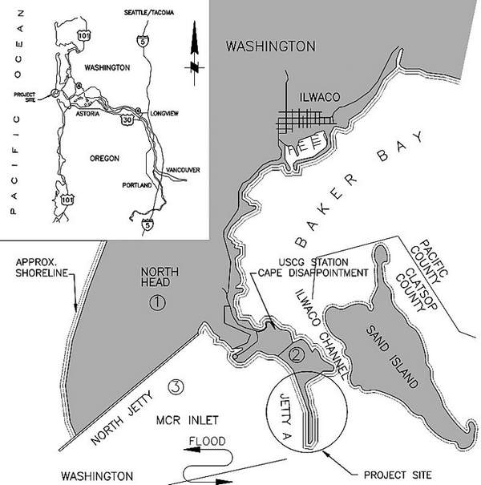
Extra Jetty Meanings

Slide 111
Extra Jetty Meanings
Filename:
Francis_Street_JettyNEW.jpg
Alt Text:
A wooden pier next to a body of water
Description generated with very high confidence

Slide 112
Names
Meanwhile, the names of many places don’t reflect these more precise semantics
  Canary Wharf
  Wigan Pier
See also: Construction Loans etc.

Slide 113
Lexical Space
Things where you
can land a boat
Things that are
solidly made
Things that are
open
Things that are
parallel to shore
Quay
Wharf
“Jetty”
Things that are
not parallel to shore
Jetty
Pier

Slide 114
The Nyms
Nym | Definition: Words having | Examples
Synonym | Same meaning | Equity instrument Share
Homograph | Same spelling Different meaning May have same or different pronunciation | Share (instrument) Share (divide)
Heteronym | Same spelling Different meaning and Different pronunciation | Bass fish Bass musical register
Heterograph | Same Pronunciation Different spelling and Different meaning | To Too Two
Homonym | Same pronunciation Different meaning Usually the same spelling | Fair (event) Fair (weather condition)
Homophone | Same pronunciation Different meaning Usually different spelling | Fair Fare

Slide 115
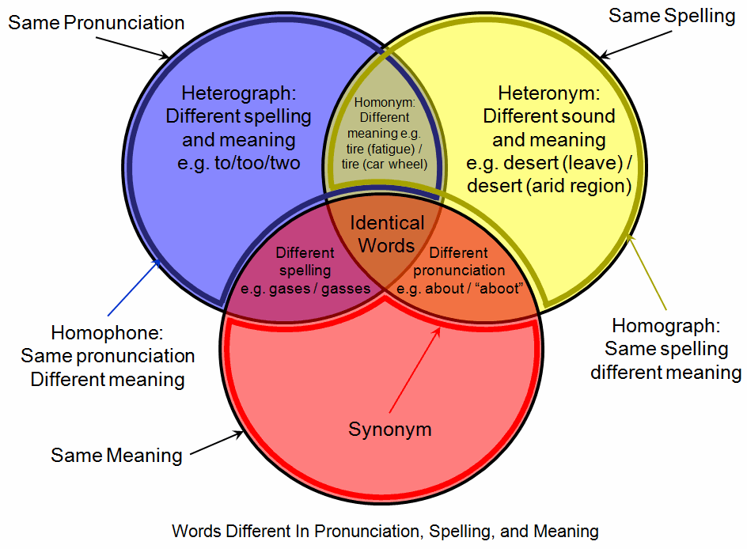
The Nyms

Slide 116
Synecdoche
Syn-ek’-do-ky (n)
  Referring to a whole by the name of some part, or a part by the name of the whole
Examples
  “The Police have arrived”
  “All hands on deck”
(“Synecdoche, New York” – great movie, incidentally about ontological commitment!)

Slide 117
The Meaning of Loan
Loan:
  “An amount drawn down by a borrower on a given date, from a lender, with terms for repayment and interest payment”
Not everything suffixed “Loan” fits into the set of things logically defined with this definition
  Construction Loan: a credit facility, with periodic draw-downs (loans) against agreed construction milestones
  Student Loan: may be a credit facility or a loan depending on how the agreement is structured
Words are not Meanings!

Slide 118
The Meaning of Fund
Fund
Pool of Resources
Financial Instrument
is a
is a
Legal Entity
Negotiable
Financial Instrument
is a
is a
Fund Entity
is held by a
Fund
is traded as a
Fund Unit
is a
is managed by a
Fund Management
Company
The term (label) “Such and Such Fund” may be used in normal speech to refer
to any one of the Fund Entity, the Fund (as a pool of resources) and the fund unit

Slide 119
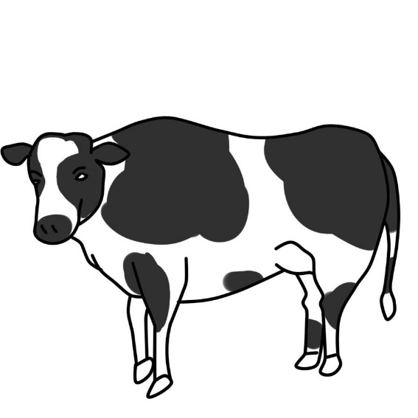
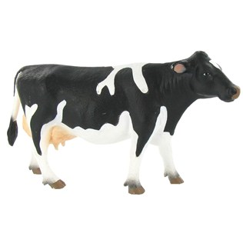

The Mombe Problem
Mombe
(Swahili: Ng’ombe)
Cow
Bull

Slide 120
Some concepts don’t have words at all
Some abstractions in the ontology are more general than any commonly used word
Sometimes there are two or three concepts which you need to specify very exactly, for which the words in language are less exact
  Client and Customer
  Commitment and Obligation
Ontology:
  Define the concept, think of the best word
Vocabulary:
  Think of a word, define each concept it ranges over
Once you have allocated a word to a concept, don’t expect every use of the word to be covered by that concept
  Especially in formal regulations!

Slide 121
Ontological Techniques

Slide 122
Ontological Techniques
Contextually defined Things
Continuant v Occurrent Things
Abstract Things
Information artifacts
Data as a thing
Social Constructs
Time and temporality
Today we look at the Contextually Defined Things and then data

Slide 123
Relative Things
We added Pontoon
This are many things you can land a boat on
Some jetties you can’t land or unload, they are just for managing tidal currents
What jetties are for versus what they are
What pontoons are for (always built for that purpose)
What does it mean to be something defined by its function?

Slide 124
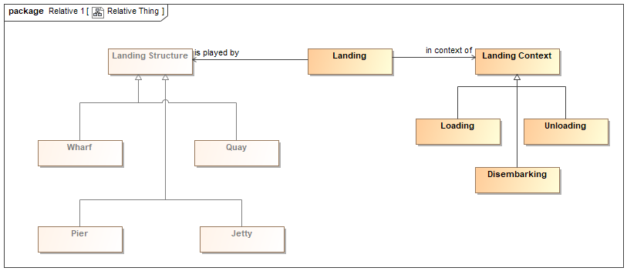
Landings – a Relative Thing

Slide 125
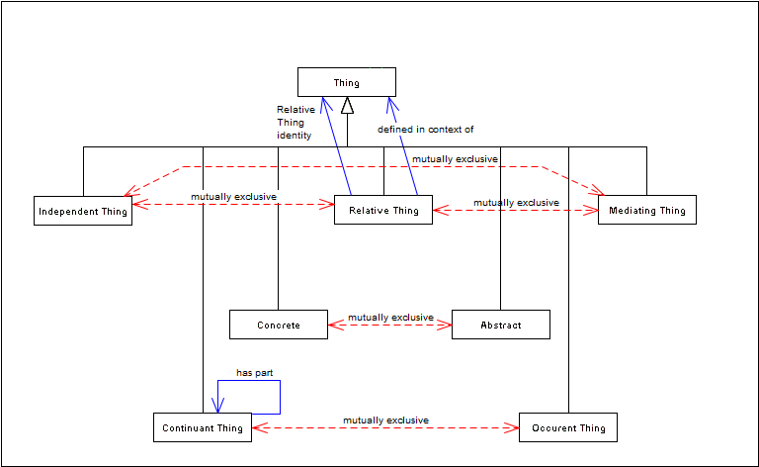

Upper Ontology Partitions

Slide 126
The ‘Relatives’ Partition
Everything which may be defined falls into one of three categories:
Thing
Independent Thing
Relative Thing
Mediating Thing
“Thing in Itself”
e.g. some Person
Thing in some context
e.g. that person as an employee, as a customer, as a pilot…
Context in which the relative things are defined
e.g. employment, sales, aviation

Slide 127
Definitions: John F Sowa
Independent categories are characterized by monadic predicates defined in terms of some entity x by itself (including its inherent parts and properties) and not in terms of anything external to x.
Relative categories are characterized by dyadic predicates that relate an entity x to some external entity y that can exist independently of x.
Mediating categories are characterized by triadic or higher predicates that show how an entity x mediates two or more entities (y,z, . . .) and thereby establishes new relationships among them.

Slide 128
Definitions: Conceptual Ontology
Identity Bearing Thing: a thing in its own right
Relative Thing: A thing defined specifically and only in relation to some context.
Mediating Thing: That’s (context) which brings together two or more independent things into some relation, usually resulting in their being defined as Relative Things.

Slide 129
The ‘Relatives’ Partition
Thing
Identifiable Thing
Relative Thing
Mediating Thing (context)
Person
Employee
Customer
Pilot
Employment
Sales
Aviation
“played by” relationship:
That which performs the
role of the “Relative Thing”

Slide 130
The ‘Relatives’ Partition
Thing
Identifiable Thing
Relative Thing
Mediating Thing (context)
Person
Employee
Customer
Pilot
Employment
Sales
Aviation
“In context” relationship:
Context in which the Independent Thing
performs the role of the “Relative Thing”

Slide 131
The ‘Relatives’ Partition
Thing
Identifiable Thing
Relative Thing
Mediating Thing (context)
Person
Employee
Customer
Pilot
Employment
Sales
Aviation
“played by”
“In context”
Everything which may be defined falls into one of these three categories
In order to complete a model of business terms and definitions, all three are needed
This extends beyond conventional ontology applications into a full and legally nuanced conceptual ontology

Slide 132
Subsequent Refinement
Thing
Identifiable Thing
Mediating Thing (context)
Relative Thing
“played by”
“In context ”
Actually
  playedBy relation may sometimes be another Relative Thing
  inContextOf is sometimes an Independent Thing
Promoted both to Thing
  Comparable with BFO
  Not all contexts are “Mediating Thing”

Slide 133
Mediating Thing as Context
Not all relative things are relative to a thing that we would consider as a mediating thing,
  but contexts always create relative things
  Mediating Thing is one kind of context in that it brings together 2 or more things in defined roles or functions
Includes business areas, process workflow, customer ad client relationships etc.

Slide 134
Hierarchy of Contexts: Pilot
Person
Pilot
Aviation
played by
In context
Commercial Pilot
In context
Commercial Aviation
Pilot of M101
In context
Flight MH101
John
played by
Your pilot today
In context
Flight MH101 on 18 Oct 2017

Slide 135
Hierarchy of Contexts: Customer
Legal Person
Bank Client
Bank Client Relationship
played by
In context
Natural Person
Retail Customer
Retail Customer Relationship
Organization
Current Account Holder
Current Account Relationship
Loan Borrower
Loan Relationship

Slide 136
Other Context Treatments
What else can be the kind of thing that is the context for some contextually determined thing (Relative Thing)?
  Catalyst
  Activity (Actor)
  Party (as in ‘party to’)
  Functional item (tools, instrument, functional business entity)
  Reference e.g. derivatives underlying, reference document
Anything the meaning of which is dependent on some context
  NOT the same as ‘Dependent’ for its existence!

Slide 137
When Not to use Relative Thing?
Most things that can described relative to a context, may also be describable in independent terms as a thing in itself, with specific capabilities that fit it to that context
  Pilot, doctor, employee
Figure out how the business (or its data) carves up its world and do that

Slide 138
John as a Person
John
has a
Pilots License
Status
has status
Current
John has a pilot’s license
John has sufficient flying hours logged to be current
John (as a instance of an Independent Thing) is a pilot

Slide 139
Ontology Partitioning 2
Thing
Continuant
Occurrent

Slide 140
Ontology Partitioning 2
Thing
Continuant
Occurrent
Continuant: where it exists it exists in all its parts
  Even if these change over time
Occurrent: the concept is only meaningful with reference to time

Slide 141
Ontology Partitioning 2
Thing
Continuant
Occurrent
Person
Contract
Pilot
Event
State
Etc.
Continuant: where it exists it exists in all its parts
  Even if these change over time
Occurrent: the concept is only meaningful with reference to time

Slide 142
Ontology Partitioning 2
Thing
Continuant
Occurrent
Person
Contract
Pilot
Event
State
Etc.
Things which are identity bearing or relative are also either continuant or occurrent

Slide 143
Ontology Partitioning 2 Example
Thing
Continuant
Occurrent
Me
My life
Me: where I exist I exist in all my parts
  Even if these change over time
My life: happens over a period of time and cannot be defined without time

Slide 144
Introducing Data

Slide 145
Introducing Data
Introducing data to ontology
Things versus Strings
Truth makers and data surrogates
What about real things that are data?
Information kinds versus datatypes

Slide 146
Suppose we have some data…
Historical data about the wharf
Local authority planning data for wharf development
In (1) The wharf is 10 feet above sea level
In (2) the same wharf is 2.5m above sea level
What do we make of the data?
  How do we use it?
  What is its relation to the ontology?

Slide 147
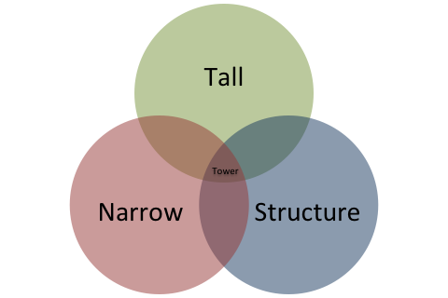
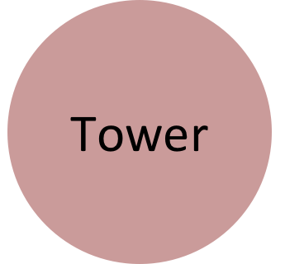

Introducing Data to Ontology
 | Things | Information
Type | A set specification for a kind of Independent Thing that generalizes all towers (e.g., “a tall narrow structure”) | A set specification for a kind of Dependent Continuant that is a record structure containing tower observations (e.g., a “TOWER” table or a “#Tower” class)
Sets | One of many sets of independent things that generalize all towers | One of many sets of dependent continuant record structures containing tower observations (e.g., in that database there)
Member | A member of zero or more sets of all towers (E.g., the actual one we call the “Eiffel Tower”) | A member of one or more sets of record structures containing tower observations (E.g., one that represents the actual Eiffel Tower) “#tower123”
Represents
Jim Logan, NoMagic

Slide 148
Data Surrogates versus Real Things
Look for signatures in data that imply the presence of real world, identifying matter
Frame the necessary conditions for membership of a class (in a logical ontology) in terms of what would be found (true) in data when the class of thing is there
Inference as distinct from meaning in the original sense
From the data you can infer that a thing exists in reality
Real meaning – by definition mostly does not rely on data!

Slide 149
Examples
Meaning of Bank: framed in terms of legal capabilities and rights
  Data surrogate: banking license
Ownership and Control
  Confer certain rights and involve certain capabilities
  These are social constructs not data
  Data surrogates: documents, deeds, shares etc.

Slide 150
Data as Real Things
There are also things in the real world that are made of information
  Information Construct as a high level class of Thing
  Names, publicly issued IDs, ratings, codes, documents, messages etc.
These are on the “real world” side of the Rhombus
  There will also be data “about” these

Slide 151
Other implications
Names:
  Name as an ontological class of thing
  Name as text
Dates and Times
  Temporal matter
  XSD datatypes for Date, DateTime etc.
  What is “Date”?
Value Types

Slide 152
Information Kinds
Names
Textual material
Dates and Times
Yes or No (or maybe)
Numbers
  Whole numbers
  Numbers with decimal places
  Positive Numbers
  Fractions
  Percentages
URL
Pictures
Sounds
Words
Letters
And many more…

Slide 153
Datatypes
Text
  Restricted text
  Unrestricted text
Dates and Times
Boolean
Numeric datatypes
  Integer
  Float
  Positive integer, positive float
URL/URI
Other information kinds are rendered in files, for example vector graphics, rich text, video and sound formats

Slide 154
Relating information kinds to datatypes
Different kinds of information need to be stored in a computer
Datatypes determine how these are stored for optimum memory usage
  XML datatypes differ on this, in that textual conventions are used to render different datatypes, which must then be translated to application datatypes for processing if needed
Numeric datatypes allow for arithmetic calculations on the data
Textual datatypes allow for alphanumeric sorting

Slide 155
Implications for Ontologies
OWL ontologies use a rather restricted sub-set of the XML datatypes set
  These are chosen in line with operational constraints on reasoner applications
  These constraints have no place in a conceptual ontology
We need to translate real world kinds of information into OWL XML datatypes for any onward processing in operational ontology applications
  Just we also will if using the ontology to derive applications in other architectures
Also a conceptual ontology must be presented to the business for validation in their own terms
  SMEs not only do not know about technical datatypes, they officially don’t care!
Let’s look at some example comparisons

Slide 156
Names
A name identifies a person or a thing
A name typically consists of a set of sounds and a corresponding set of letters making up the spoken word which is that person’s name
Translating to datatypes
  Names are generally rendered as textual datatypes, often with a length limitation to suit the application
Notes:
Now in the real (conceptual) world a name may be infinitely long, whereas in computer systems we come up with some sensible length limit. A name may be in any alphabet, while in computer systems it must be rendered in some alphabet supported by Unicode or something similar. So for instance the Scottish name Menzies can't be accurately represented because the Scottish letter Yau never made it into these computer alphabets (someone correct me if this is somewhere in Unicode) and so it is generally rendered with a Z - and has been for so long, including in typewriters, lead type etc. that the use of Z has become the accepted rendition.

Slide 157
Answers and Booleans
Business (reality)
  There are certain kinds of question for which the answer is
    Yes or No
    Yes, No, Maybe
    Yes, No, Maybe, don’t know, it isn’t as simple as that…
Some propositions necessarily require a binary answer
  “Is today Wednesday” only has two valid answers
    The “don’t know” option is covered under the Open World Assumption
Others do not
Computer
  A boolean returns the truth value of a proposition
  Usually a good match for many of these question types
  It does not mean strictly the same thing though
  Many data sources use booleans where a binary choice of values exist in the data
    Contract: isNegotiable (boolean)
    It either is or it isn’t.

Slide 158
Dates and Times
Business (reality)
  A date is simply an index to a day
    The first of September 2014
    6 Elul, 5774
  The calendar is the scheme which defines that index
Computer
  Date
  DateTime
OWL
  DateTime only (for some egregious reason)
    Therefore the data which is fed in has to have values set as midnight (making them indistinguishable from things that actually happen at dead of night)
The day I wrote this slide

Slide 159
Implementation:
Making it Real

Slide 160
Introducing the Semantic Web
Web Ontology Language (OWL):
  Triples (Subject – predicate – Object)
Model Formalism: First Order Logic
  SMIF, OntoUML, OWL, ODM
Model Theory (semiotics):
  What the items in the model represent: Concepts
  Conceptualization of real world things
  Legal, accounting etc.

Slide 161
Subject-predicate-Object
Subject
predicate
Object

Slide 162
Subject-predicate-Object
This is formal assertion
(like a verb)
Subject
predicate
Object
This is a class of “Thing”
Defined in set theoretic terms
This may be another class of “Thing”
or it may be a basic type e.g. number

Slide 163
Classification
Thing
Classes of thing are classified
according to what type of thing they are
Is a
Thing
predicate
Thing

Slide 164
Triples
Thing
All of these assertions are called “Triples”
and are stored in some kind of “Triple store”
Thing
predicate
Thing

Slide 165
Ontology Styles
Stand-alone application:
  Keep the properties under-specified
  Meaning inheres in the whole graph when reasoning over
  Complex graph to ensure it matches an unambiguous set of things about the world
Concept Ontology
  Specify domain and range
  Introduce abstractions as needed to do this
  Use more qualified predicate names
  Most times, the intended meaning of the property is much narrower than the usual usage of the word in human language
    Don’t let language games mess up your ontology!

Slide 166
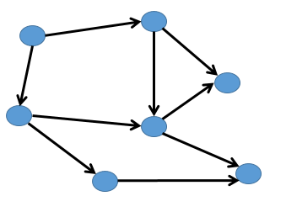
Deep and Shallow Ontologies
Self-contained classes, properties
and logical statements corresponding
to some set of things in the world

Slide 167
Deep and Shallow Ontologies
Deep classification hierarchy of types of thing
in the world, with relationships and sufficient
logic to disambiguate

Slide 168

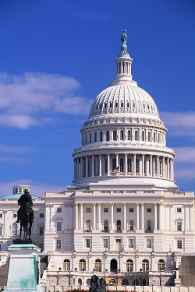

Semantic Grounding for Businesses
What are the basic experiences or constructs relevant to business?
    Monetary: profit / loss, assets / liabilities, equity
    Law and Jurisdiction
    Government, regulatory environment
    Contracts, agreements, commitments
    Products and Services
    Other e.g. geopolitical, logistics

Slide 169
Where does this lead?
Taxonomy of kinds of contract
Taxonomy of kinds of Rights
  Rights, Obligations are similar and reciprocal concepts
  Note that these don’t necessarily correspond to data
Semantics of accounting concepts
  Equity, Debt in relation to assets, liabilities
  Cashflows etc.
Semantics of countries, math, legal etc.

Slide 170
Shallow: Internal Consistency
Graph has logical relations between elements
These correspond to the relations between things in reality
Automated reasoning checks the “deductive closure” of the graph for consistency and completeness

Slide 171


Shallow: Internal Consistency
Graph has logical relations between elements
These correspond to the relations between things in reality
Automated reasoning checks the “deductive closure” of the graph for consistency and completeness

Slide 172
Internal Consistency Semantics
The more detailed logic there is in the application ontology, the more confident we can be that it reflects only one set of things and their relation in reality
  Like Jabberwocky
  Or a crossword solution
This allows for stand-alone ontologies to do very powerful processing of knowledge in an application
This is not incompatible with the techniques described for conceptual ontology modelling – IFF it is done right!
However, some techniques which are appropriate for stand-alone operational ontologies would not be compatible with a conceptual enterprise ontology
Decide whether to have application and conceptual ontologies in separate namespaces, or satisfy both sets of requirements in one namespace

Slide 173
Application vs. Reference Ontology
Application Ontology
  Built to support a particular application (use case)
  Reused rather than define terms
  Skeleton structure to support application
  Terms defined refine or create new concepts directly or through new classes based on inference
Reference Ontology
  Intended as an authoritative source
  True to the limits of what is known
  Used by others

Slide 174
Reference Ontology

Slide 175
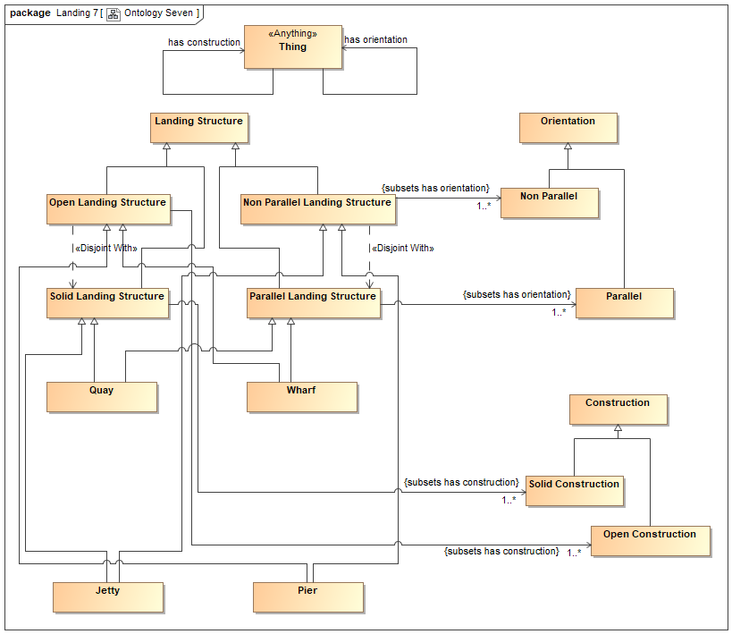
Application Ontology
Suitable for ‘Operational ontology’

Slide 176
Model Positioning
Conceptual Model
Realise
Logical Model (PIM)
Implement
Physical Model (PSM)

Slide 177
Model Positioning
Conceptual Model
Business
Realise
The Language Interface
Logical Model (PIM)
Technology
Implement
Physical Model (PSM)

Slide 178
This is not a more abstract model of the solution…
Conceptual Ontology
Business
Realise
The Language Interface
Logical Data Model (PIM)
Technology
Implement
Physical Data Model (PSM)

Slide 179
This is not a more abstract model of the solution…
It’s a concrete model of the problem!
Conceptual Ontology
Business
Realise
The Language Interface
Logical Data Model (PIM)
Technology
Implement
Physical Data Model (PSM)

Slide 180
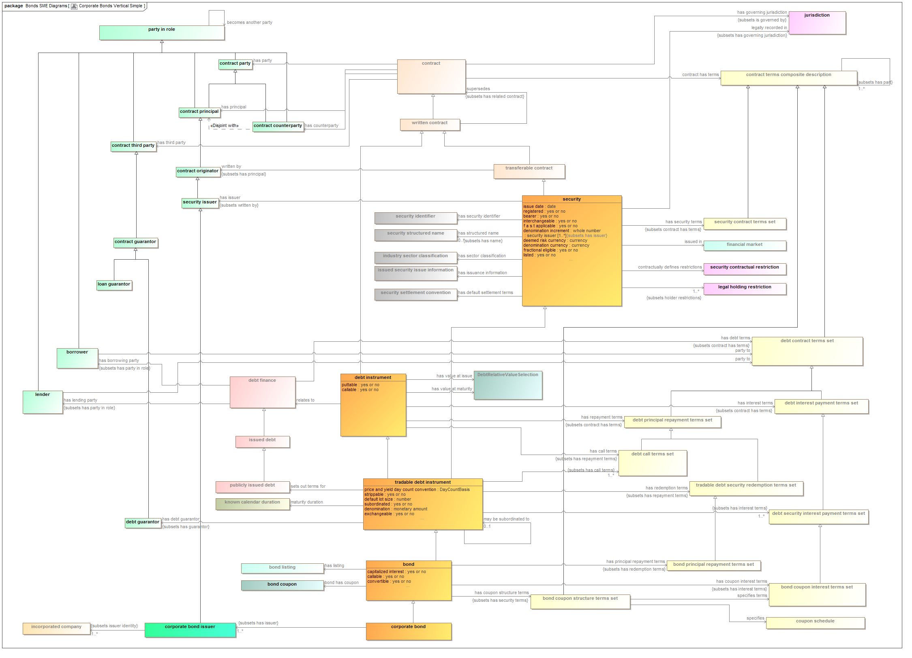
Subject Matter Expert Validation

Slide 181
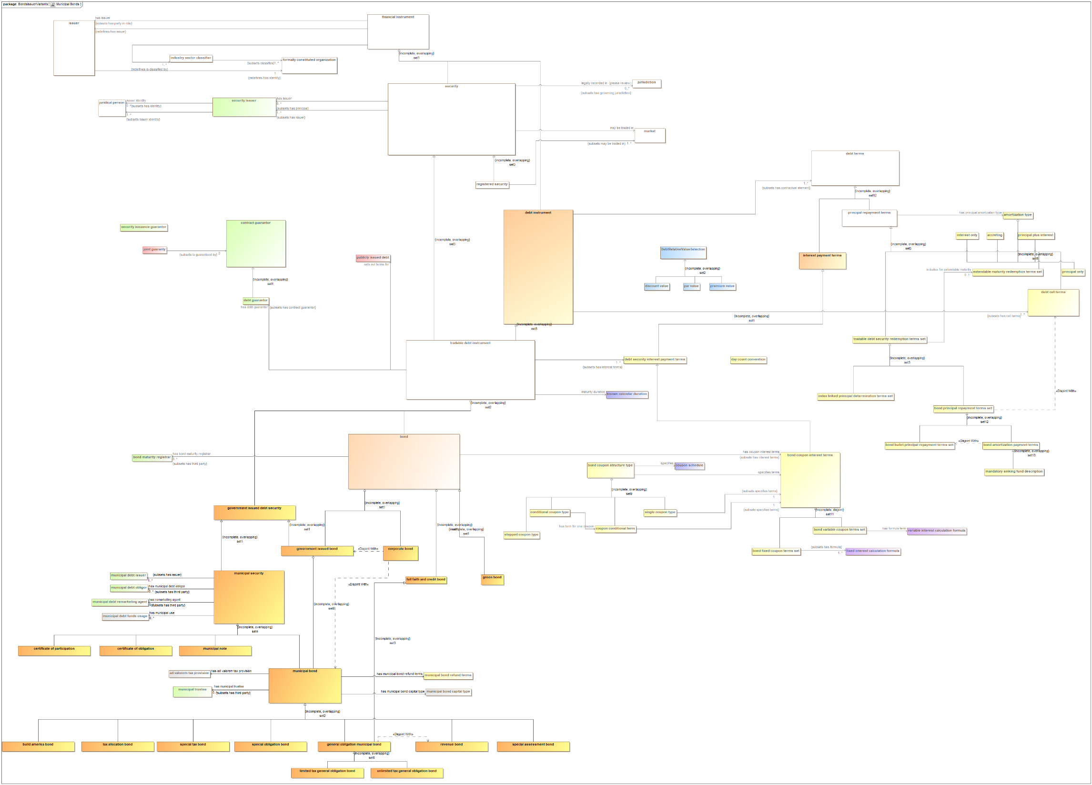
SME Validation: Explaining Diagrams
Foundational concepts
for Contracts
Terms common to all debt
Interest, Principal terms
common to Bonds
Terms specific to Municipal Bonds

Slide 182
Mapping and Data Integration
Not as simple as that…
One concept may be modelled in different data element combinations
One data element may refer to a whole path through the ontology graph
Conceptual model must be general enough that a range of different logical designs can be referenced to it
  E.g. stand up wide range of Relative, Occurrent etc along with property chains and intermediate classes

Slide 183

Ontology to Data Model

Slide 184

Data Model to Ontology

Slide 185
Customer Relationships Data: Current State
To make data reusable the contexts implicit in application siloes must be made explicit. Consider a set of applications for relationships between the bank and some party. Each silo combines relationship-specific data, entity data and historical records of the product or loan application.
Bank
Data Siloes
CRM₁
CRM₂
CRM_{n}
There are various points at which the bank interacts with a given person (customer for various products)
Full name
Customer ID
Purchase date
Phone
Address Line 1
…
City
Country
First name
Family name
Customer ID
Drawdown date
Credit rating
Address
Country of Birth
Name
Customer ID
Date of Birth
Purchase date
Phone
Address Line 1
…
Country of Collateral
Legal Person

Slide 186
Customer Relationships Data: Future State
The Ontology makes implicit contexts explicit. It provides contextual semantics, distinguishing concepts specific to relationships, historical records (e.g. loan applications), current information for entities, and others. This is independent of the deployment benefits of semantic technology.
High Level Ontology
Contexts:
Time
Role / Relationship
Records / history
etc.
Purchase
date
Current
date
Ontology provides the context for each kind of data
Full name
Customer ID
Purchase date
Application Credit rating
Phone
Address Line 1
…
City
Country of Domicile
Customer ID
Purchase history
Contact Phone
Customer ID
Drawdown date
Payment history
Customer ID
Purchase date
Country of collateral
Relationship (context) specific data
Non context specific data becomes real-time entity data
Entity Data
Address
Records: Loan application data
First name
Family name
Current Credit rating
Date of Birth
Home Phone
Country of Birth
Address Line 1
..
Address line n
City
State
Country
Independent entity data

Slide 187
Ontology and Context
Ontology takes the contexts that are implicit in various data models and makes them explicit
“Meaning is Context”
  Trivially true
  The meaning of word is highly context dependent
  The meanings of data elements also contextual to the application use case

Slide 188
Context: Conceptual and Operational
“Conceptual”
Ontologies
= Context
Various operational
Ontologies
Some operational
Data models
Various bits of content

Slide 189

Concepts Extraction: Application Ontology
Context-specific concept models
= Context
N-dimensional content
Shown as 4D for simplicity
Various extracts from
that hypercube in lower dimensionality

Slide 190
Concepts Extraction: Time
Context-specific concept models
Real-time context
Real-time context
Current time snapshot
Historical context
Historical context
N-dimensional content
Shown as 4D for simplicity
Time series (history)

Slide 191
Concepts Extraction: Granularity
Context-specific concept models
More and less granular content
Shown as 3D for simplicity
Various extracts in higher
or lower granularity

Slide 192
Vocabulary
Context-specific concept models
Vocabulary
Local Context
Vocabulary
Ontology
N-dimensional content
Shown as 4D for simplicity
Various extracts from
that hypercube in lower dimensionality

Slide 193
Thank You!
Mike Bennett
Hypercube Ltd – a member of the Semantic Shed www.hypercube.co.uk

