Slide 1

Conceptual Semantics:
How to Build a
Golden Ontology
Webinar
8 April 2015
Mike Bennett
Hypercube Ltd.

Slide 2
Jabberwocky
‘Twas brillig and the slithy toves
Did gyre and gimble in the wabe
All mimsy were the borogoves
And the mome raths outgrabe
Lewis Caroll

Slide 3
Agenda
3 things you need to know about ontologies
  Words are not Concepts
  Syntax is not Semantics
  Meaning is not Truth
3 things you need to do to build a Golden reference ontology
  Classification
  Abstraction
  Partitioning
3 ways to use a Golden Ontology
  Querying across legacy data sources
  Mapping and data integration
  Reasoning with Semantic Web applications

Slide 4

The Knowledge-enabled Enterprise
Reporting etc.
Enterprise Conceptual Ontology
Legacy Data Sources and Systems

Slide 5
Model Positioning
Conceptual Model
Realise
Logical Model (PIM)
Implement
Physical Model (PSM)

Slide 6
Model Positioning
Conceptual Model
Business
Realise
The Language Interface
Logical Model (PIM)
Technology
Implement
Physical Model (PSM)

Slide 7
3 Things you need to know
Words are not Concepts
Syntax is not Semantics
Meaning is not Truth

Slide 8
1. Words are not Concepts

Slide 9


The Meaning of Football
Football (USA)
Football (everywhere else)
These are “heteronyms” (same word, different meaning)

Slide 10
The Meaning of Football
Soccer ball (USA)
Football (everywhere else)
These are “synonyms” (different word, same meaning)

Slide 11
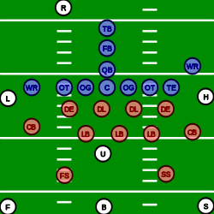
The Meaning of Football
Football (a ball)
Football (the game)
These are “heteronyms” (same word, different meaning)

Slide 12
The Meaning of Loan
Loan:
  “An amount drawn down by a borrower on a given date, from a lender, with terms for repayment and interest payment”
Not everything suffixed “Loan” fits into the set of things logically defined with this definition
  Construction Loan: a credit facility, with periodic draw-downs (loans) against agreed construction milestones
  Student Loan: may be a credit facility or a loan depending on how the agreement is structured

Slide 13
The Meaning of Fund
Fund
Pool of Resources
Financial Instrument
is a
is a
Negotiable
Financial Instrument
Legal Entity
is a
is a
Fund Entity
is held by a
Fund
is traded as a
Fund Unit
is a
is managed by a
Fund Management
Company
The term (label) “Such and Such Fund” may be used in normal speech to refer
to any one of the Fund Entity, the Fund (as a pool of resources) and the fund unit

Slide 14
The Meaning of Legal Entity
Legal Entity (1)
  an autonomous entity which is capable of legal liability
    Synonym: Legal Person
Legal Entity (2)
  a partnership, corporation, or other organization having the capacity to negotiate contracts, assume financial obligations, and pay off debts, organized under the laws of some jurisdiction
    Synonym: LEI Legal Entity
    Source: ISO 17442

Slide 15
2. Syntax is not Semantics

Slide 16
Let’s look at Jabberwocky again…
‘Twas brillig and the slithy toves
Did gyre and gimble in the wabe
All mimsy were the borogoves
And the mome raths outgrabe

Slide 17
Let’s look at Jabberwocky again…
‘Twas brillig and the slithy toves
Did gyre and gimble in the wabe
All mimsy were the borogoves
And the mome raths outgrabe
When is brillig?
What kind of thing is a tove?
How does one gyre?
How does on gimble?
What’s a wabe?
and the wabe of what?
What are raths?
What is a borogrove?
What does it mean to be mome?
What makes them mimsy?
What does outgrobing consist of exactly?

Slide 18
Let’s look at Jabberwocky again…
‘Twas brillig and the slithy toves
Did gyre and gimble in the wabe
All mimsy were the borogoves
And the mome raths outgrabe
When is brillig?
What kind of thing is a tove?
How does one gyre?
How does on gimble?
What’s a wabe?
and the wabe of what?
What are raths?
What is a borogrove?
What does it mean to be mome?
What makes them mimsy?
What does outgrobing consist of exactly?
‘Tis all nonsense …
Or is it?

Slide 19
Syntax and Semantics
A little syntax goes a long way
  The English syntax in Jabberwocky narrows down the space of possible things in the world that the poem can be talking about
  We can identify some of the semantics of the concepts from the syntax that links them in formal syntactical relationships
  But not all!
The same would be the case with a logical syntax
But it doesn’t deal with all the semantics!

Slide 20
Logical Syntax
Try this test:
  Take a logical data model expressed in e.g. UML
  Transform the UML into OWL
  What do you have?

Slide 21
Logical Syntax
Try this test:
  Take a logical data model expressed in e.g. UML
  Transform the UML into OWL
  What do you have?
You have a logical data model in OWL!
  Changing the syntax did not make it an ontology
  Similarly but less obviously, a set of code lists in OWL is not an ontology!

Slide 22
3. Meaning is not Truth

Slide 23
Logical Syntax
Allows us to determine the truth value of propositions

Slide 24
Logical Syntax
Allows us to determine the truth value of propositions
A
C
If (A and B) then C
B

Slide 25
Logical Syntax
Allows us to determine the truth value of propositions
A
C
If (A and B) then C
B
Given a truth value for A and for B, then C is true

Slide 26
Web Ontology Language (OWL)
Declarative statements about kinds of thing and properties of those kinds of thing
Framed in a sub set of First Order Logic (FOL)
Lets us make logical statements about the relationships between kinds of thing
OWL is limited in its expressive power, but what we can express depends on how we frame the semantics of the concepts (the kinds of thing and the relationships among them)
The syntax allows us to say things clearly and unambiguously in a way that is readable by machines and by people
It is computationally independent!

Slide 27
Meaning is not Truth
The logic lets us infer truth values based on assertions in the model and in the available data
  Running a reasoned will uncover these relations
Logic (truth values) provides a means to an end
  This is not the same as saying logic / truth “is” semantics
Some people would say “this model has no semantics” when they mean it has no logic from which to determine truth values

Slide 28
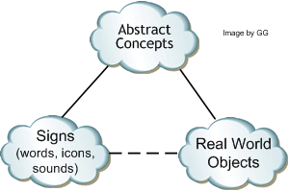
Semiotics
(after C. S. Peirce)

Slide 29
3 Things you need to do
Classification
Abstraction
Partitioning

Slide 30
Capturing Meaningful Concepts
For each kind of “Thing” in the ontology (each class):
  What kind of thing is this?
  What distinguishes it from other things?

Slide 31
What is an Ontology?
An ontology is a representation of real things using formal logic

Slide 32
Defining a Kind of Thing
We start with some kind of thing
Some kind of thing

Slide 33
Defining a Kind of Thing
We ask just two questions about this kind of thing:
  What kind of thing is it?
  What distinguishes it from other things?
Some kind of thing

Slide 34
What kind of thing is it?
Animal
Vertebrate
Invertebrate
Bird
Mammal
Fish
Waterfowl
Some kind of thing

Slide 35
What distinguishes it from other things?
Animal
Vertebrate
Invertebrate
Bird
Mammal
Fish
Waterfowl
Walks like a duck
Some kind of thing
Swims like a duck
Quacks like a duck

Slide 36
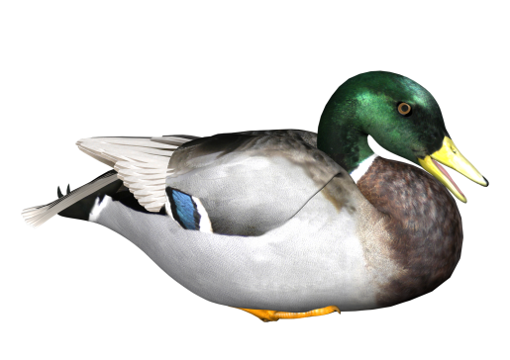
It’s a Duck!
Animal
Vertebrate
Invertebrate
Bird
Mammal
Fish
Waterfowl
Walks like a duck
Swims like a duck
Quacks like a duck

Slide 37
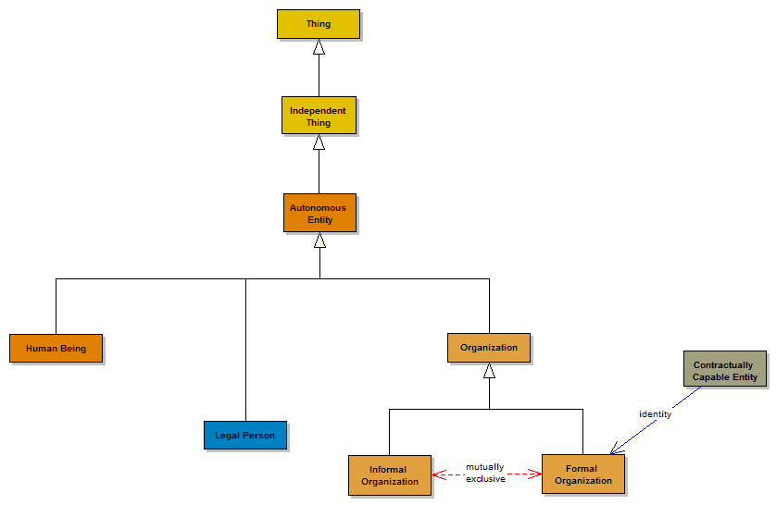
FIBO Example: Business Entities

Slide 38
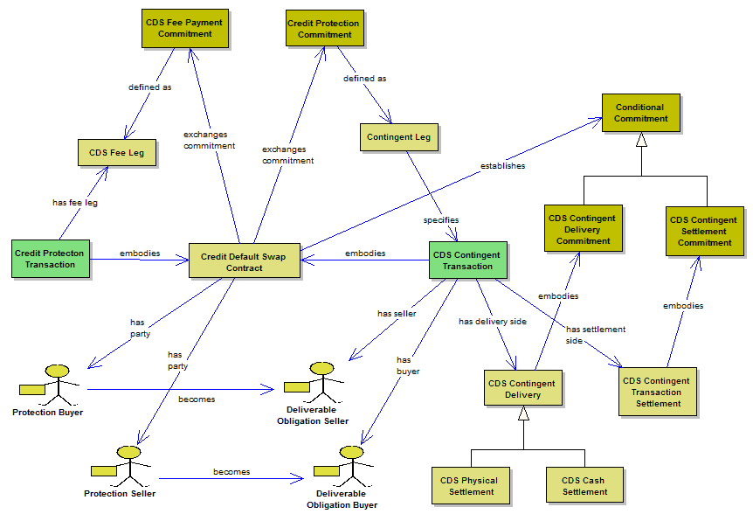
FIBO Example: Credit Default Swap

Slide 39
1. Classification
Taxonomic relations
  Taxonomies in general may be based on several kinds of hierarchical relations
  We use only the “is a” relation (sub class of)
Faceted Classification
  Allow multiple inheritance of classes
    Derivatives -> contract types (forward, option, swap)
    Derivatives -> underlying types (commodities, rates, indices, instruments)

Slide 40
Faceted Classification

Slide 41
Hierarchical Taxonomies
Typically use one-to-many relationships
Some one-to-many relationships are not associated with hierarchies
  The relationship between a person and his/her phone numbers
Some hierarchical relationships are not one-to-many
  A thing with only one part (e.g., Wyoming has only one congressional district)
Some hierarchies have no relationships at all
  A hierarchy of income brackets

Slide 42
Transitive recurrent relationships
Common varieties: Type of, part of
Military hierarchies: Commands
Relationships that apply particularly to finance?
  In addition to “type of” and “part of”
Transitivity violations
A certain rock is considered to be a chair. Chairs are considered furniture. But the rock is not considered furniture
An executive supervises a middle manager. The manager supervises a technician. But (perhaps) the executive has no relationship to the technician.
Usually involve second-order (extrinsic) concepts

Slide 43
Polyhierarchies
Categories with multiple superordinates
  Dog can be nested under both Canine and Pet
    Alternative treatments exist for “pet”
  Financial Examples
    An IR Swap is both a swap and an interest rate derivative
    Swaption can be nested under both Swap and Option
Polyhierarchies may be
  Expressed directly through multiple inheritance
  Ordered (determine sequence in which to apply a given facet)

Slide 44
Classification: To infer or not to infer?

Slide 45
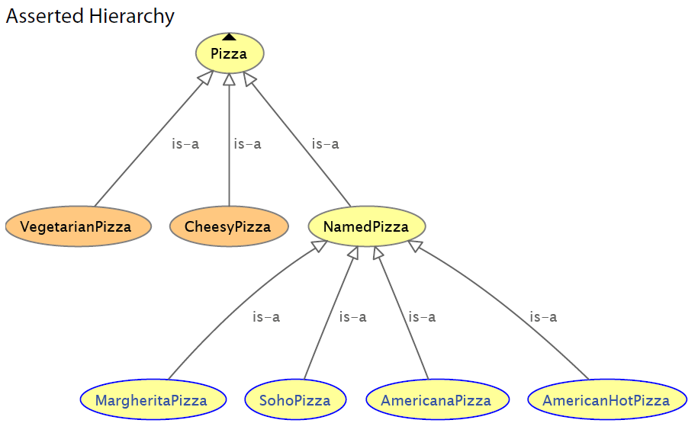
Pizza: Asserted

Slide 46
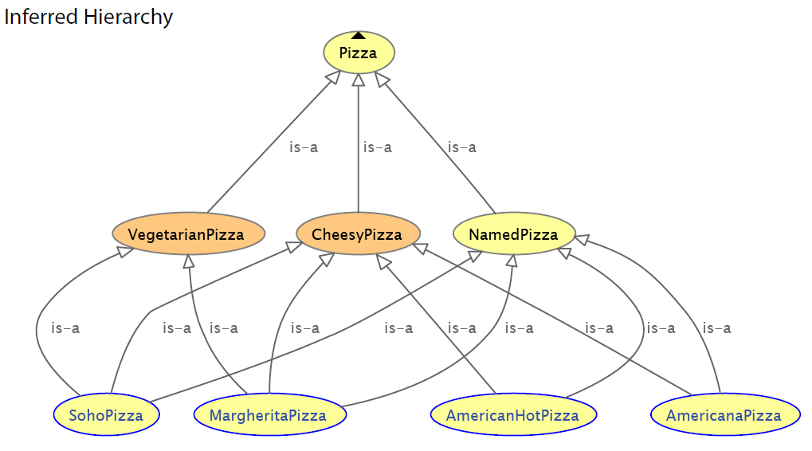
Pizza: Inferred

Slide 47
To infer or not to infer?
Can use logical restrictions to assert things about something which would place it in a given category
HOWEVER
  This is then unreadable to the business SMEs
Make the faceted taxonomy explicit so SMEs can review it
  And then remove the additional relations in operational ontology
  Replacing these with restrictions as above
  OR
Include restrictions, run the reasoner and show SMEs the results in a business-facing format

Slide 48
2. Abstraction
How to abstract concepts
Top down versus bottom up
Where to stop?
Use of use cases
Not everyone is comfortable with abstractions
This is where you really have to think about meaning
Also where you need to facilitate SME review input carefully

Slide 49
Abstract Thinking
What kind of “Thing” is …
  An address?
    An address is an index to a location
  A client? A customer?
    Related to a product / service or to a whole business?
  A securities exchange?
    How does it differ from a street market?
    What does an exchange have in common with a street market?
    Where does the classification hierarchy (taxonomy) divide?

Slide 50
Abstract Thinking
What kind of “Thing” is …
  An address?
    An address is an index to a location
  A client? A customer?
    Related to a product / service or to a whole business?
  A securities exchange?
    How does it differ from a street market?
    What does an exchange have in common with a street market?
    Where does the classification hierarchy (taxonomy) divide?

Slide 51
Abstracting concepts
Let’s look at the use case question…

Slide 52
Use Case Use Cases
Application use case:
  What the user expects the application to do
  This is behavioural (what it does) not structural (data / ontology)
  Competency questions etc.
  Applies to ontology based applications as much as any other kind of application
Conceptual Model Use Case
  This is NOT an application it’s a computationally independent model…

Slide 53
This is not a more abstract model of the solution…
Conceptual Ontology
Business
Realise
The Language Interface
Logical Data Model (PIM)
Technology
Implement
Physical Data Model (PSM)

Slide 54
This is not a more abstract model of the solution…
It’s a concrete model of the problem!
Conceptual Ontology
Business
Realise
The Language Interface
Logical Data Model (PIM)
Technology
Implement
Physical Data Model (PSM)

Slide 55
Use Cases in Conceptual Ontology
The conceptual model needs to support all of the applications and data sources for which it is intended to provide the computationally independent (business) view
Use case informs:
  The SCOPE of the model – what are the data elements for which the enterprise needs formally defined concepts?
  The Ontological Commitments:
    Granularity of concepts
    Theory of the World
    Model theories / partitions
From this we can get an idea of how far to abstract concepts in the ontology…

Slide 56
Pizze
Suppose we have a nice pizza ontology
  It covers concepts like pizza base, pizza topping
  How far should we abstract from this?
Pizza Ontology
Just pizze
Pizza Base
Pizza Topping

Slide 57
Pizze
Suppose we have a nice pizza ontology
  It covers concepts like pizza base, pizza topping
  How far should we abstract from this?
Baked Goods Ontology
Baked Food
Bread
Pizza Ontology
Pizza Base
Pizza Topping

Slide 58
Pizze
Suppose we have a nice pizza ontology
  It covers concepts like pizza base, pizza topping
  How far should we abstract from this?
Food Ontology
All food
Food
Baked Goods Ontology
Bread
Pizza Ontology
Pizza Base
Pizza Topping

Slide 59
Pizze
Suppose we have a nice pizza ontology
  It covers concepts like pizza base, pizza topping
  How far should we abstract from this?
Food and Drink Ontology
All food and drink
Digestible Thing
(Pizza, wine etc.)
Food Ontology
Food
Baked Goods Ontology
Bread
Answer: it depends on the scoping requirement for the ontology
Pizza Ontology
Pizza Base
Pizza Topping

Slide 60

A Taxonomy
“bird”
“robin”
“canary”

Slide 61
Some Observations on Abstraction
Working with subject matter experts requires careful management of the knowledge acquisition process
Pitfalls:
  Silo-based assumptions
  Localized jargon
  Reliance on words
Make sure SMEs fully understand the “set theoretic” nature of the presentation materials
Make sure they understand synonyms, heteronyms
Make sure they are aware of any ontological abstractions or “buckets” you may have in the ontology (these will not correspond to anything in the SMEs’ own experience!)

Slide 62
Some Observations on Abstraction
“Slithy Toves”
  Why do the SMEs mention that they are slithy at all?
  In the wild, most toves are glumpfy, however these are not relevant to this line of business
  Do they have to note they are slithy for reporting purposes?
  In parts of California, toves are neither slithy nor glumpfy
  Someone on the team has a partner who works in a zoo and has never come across this concept
Think beyond the context of the SMEs!
Identify what the SME’s context is (write it down!)
What other concepts are within the scope / conceptual use case?
Will your ontology need to interact with other ontologies beyond the immediate use case (e.g. schema.org or global standards?);
  if so, allow for all the realistic properties a tove may have both in captivity and in the wild!

Slide 63
3. Partitioning

Slide 64
Partition I: Independents and Relatives
Everything which may be defined falls into one of three categories:
Thing
Independent Thing
Relative Thing
Mediating Thing
“Thing in Itself”
e.g. some Person
Thing in some context
e.g. that person as an employee, as a customer, as a pilot…
Context in which the relative things are defined
e.g. employment, sales, aviation
Notes:
“All that is in Heaven and Earth”
Anything which represents a meaningful business term, i.e. something which may have a label and a definition, falls under one of the following:
Independent
Relative
Mediating

Slide 65
Independents and Relatives
Thing
Independent Thing
Relative Thing
Mediating Thing (context)
Person
Employee
Customer
Pilot
Employment
Sales
Aviation
“Has identity” relationship:
That which performs the
role of the “Relative Thing”

Slide 66
Independents and Relatives
Thing
Independent Thing
Relative Thing
Mediating Thing (context)
Person
Employee
Customer
Pilot
Employment
Sales
Aviation
“In context of” relationship:
Context in which the Independent Thing
performs the role of the “Relative Thing”

Slide 67
Independents and Relatives
Thing
Independent Thing
Relative Thing
Mediating Thing (context)
Person
Employee
Customer
Pilot
Employment
Sales
Aviation
“Has identity”
“In context of”
Everything which may be defined falls into one of these three categories
In order to complete a model of business terms and definitions, all three are needed
This extends beyond conventional ontology applications into a full and legally nuanced conceptual ontology
Notes:
This extends the use of ontology beyond mere physical, independent “Things” to everything which may be a term which the firm has to deal with and define
e.g. customer, counterparty, asset

Slide 68
Why does this Matter?
Define all concepts of interest to the business
Map to data which is framed in a context specific way
Assist with restructuring data for re-use across the firm
  E.g. business entity versus client / counterparty and other role-specific

Slide 69
Partitioning II: Continuants and Occurrents
Continuant and occurrent Things
  Ref: John F Sowa
Also known as Endurant and Perdurant
  Ref: Guarino and Welty

Slide 70
Continuants and Occurrents
Thing
Continuant
Occurrent

Slide 71
Continuants and Occurrents
Thing
Continuant
Occurrent
Continuant: where it exists it exists in all its parts
  Even if these change over time
Occurrent: the concept is only meaningful with reference to time

Slide 72
Continuants and Occurrents
Thing
Continuant
Occurrent
Person
Contract
Pilot
Event
State
Etc.
Continuant: where it exists, it exists in all its parts
  Even if these change over time
Occurrent: the concept is only meaningful with reference to time

Slide 73
Ontology Partitioning
Thing
Continuant
Occurrent
Person
Contract
Pilot
Event
State
Etc.
Things which are independent or relative are also either continuant or occurrent

Slide 74
Continuants and Occurrents Example
Thing
Continuant
Occurrent
Me
My life
Me: where I exist I exist in all my parts
  Even if these change over time
My life: happens over a period of time and cannot be defined without time

Slide 75
Why does this Matter?
Frame concepts which have a temporal component which are of interest to the business
  Events, activities
  States
  Statuses, prices, other time-variant concepts
Provide a basis for ontological modelling of business process
This brings the two sides of development (structural and behavioural) into the same conceptual model

Slide 76
Partitions III: Concrete and Abstract
Thing
Concrete
Abstract

Slide 77
Concrete and Abstract
Thing
Concrete
Abstract
Concrete: A physical thing
  Or a virtual thing in some reality
Abstract: the concept is only meaningful as an abstraction from reality

Slide 78
Concrete and Abstract
Thing
Concrete
Abstract
Pillar of Stone
Financial Instrument
Goal
Resolution
Desire
Wheelbarrow
Not as simple as physical v non physical
Concrete: not limited to 3D physical reality
Abstract: no physical or virtual expression

Slide 79
Why does this Matter?
Distinguish between concepts which have a direct physical (or electronic) expression from those which don’t
Talk about goals, strategies etc.
  Portfolio strategies – needed for compliance etc.
  Business goals – form part of formal model of risk concepts
Business motivation models can be brought into the same conceptual framework
Distinguish abstract metrics from concrete amounts of stuff

Slide 80
Conceptual Extensions
Mid Level Ontologies
  Domain independent concepts
  Reusable Semantics from other domains
Aim to identify and re-use available academic work on conceptual abstractions where these exist
  Subject to their fitting within the same set of theories as your conceptual ontology (or adapt as needed)
  A considerable body of such work exists in the applied ontology field

Slide 81
Semantic Abstractions
Inevitable by-product of the “What kind of Thing is this?” question
  Ontologies are built around a classification hierarchy (“Taxonomy”) of kinds of thing
  This is key to meaningful ontologies
Enables disambiguation across business contexts
Not a technology activity
Examples: Contract, Credit, Asset etc.

Slide 82
Semantics Re-use
Research and identify re-usable content semantics
  In formal published ontologies
  Business models in non ontological (non FOL) formats
  Technical / messaging standards to “reverse engineer” into semantics
Pre-requisite: identify abstractions needed to support the specification concepts
Examples:
  Transaction semantics
  Legal / contractual etc.
  Real Estate (for mortgage loans)

Slide 83

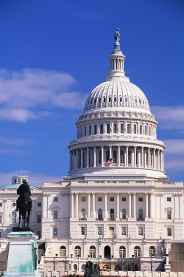

Semantic Grounding for Businesses
What are the basic experiences or constructs relevant to business?
    Monetary: profit / loss, assets / liabilities, equity
    Law and Jurisdiction
    Government, regulatory environment
    Contracts, agreements, commitments
    Products and Services
    Other e.g. geopolitical, logistics
Notes:
AKA where does the meaning get in?
Business: Grounded in the realities and sensory inputs of the organization
Monetary: profit, loss, assets
Legal: regulatory, legal environment
Ecosystem: Agreements with other organizations
Contractual and agreement
Products and services
Other e.g. jurisdiction, geopolitical

Slide 84
3 ways to use conceptual ontology
Querying across legacy data sources
Mapping and data integration
Reasoning with Semantic Web applications

Slide 85
1. Querying across Legacy Data Sources
Recommended Architectures
Wrappers and Adapters
When to stand up a triple store

Slide 86
Knowledge-enabled Enterprise
Enterprise-wide Concept Model
Ontology to Legacy Database Adapters
Legacy Data Sources and Systems

Slide 87

Knowledge-enabled Enterprise
Risk, Compliance etc.
Semantic Queries
Enterprise-wide Concept Model
Ontology to Legacy Database Adapters
Legacy Data Sources and Systems

Slide 88
Knowledge-enabled Enterprise
Reporting
Risk, Compliance etc.
Semantic Queries
Enterprise-wide Concept Model
Ontology to Legacy Database Adapters
Legacy Data Sources and Systems

Slide 89
Using “Wrappers”

Slide 90
Converting Relational Data to Graphs
25
Bob
Alice
Person
<Person#NAME>
<Person#AGE>
<Person#NAME>
ID | NAME | AGE | CID
1 | Alice | 25 | 100
2 | Bob | NULL | 100
<Person/ID=1>
<Person/ID=2>
City
CID | NAME
100 | Austin
200 | Madrid
<Person#ref-CID>
<Person#ref-CID>
<City/CID=100>
<Person#NAME>
Austin
<City/CID=200>
<Person#NAME>
Madrid

Slide 91
Integration with Ultrawrap
Target Ontology
Source 1 Ontology
Source 2 Ontology
Source N Ontology
…
Ultrawrap
Ultrawrap
Ultrawrap
Source DB 1
Source DB 2
Source DB N

Slide 92
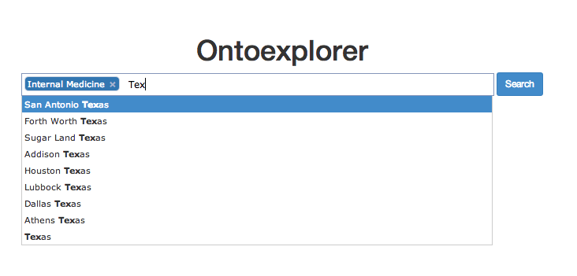
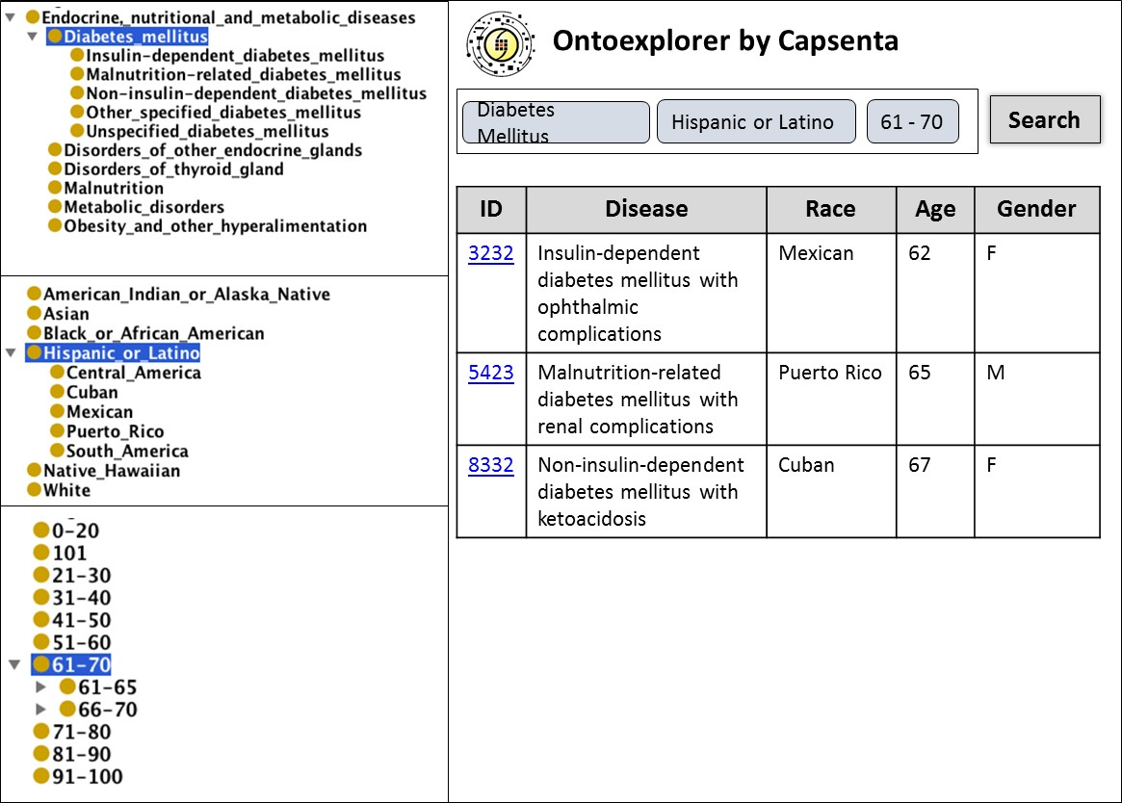
Federator
Target Ontology
Federator
Source 1 Ontology
Source 2 Ontology
Source N Ontology
…
Ultrawrap
Ultrawrap
Ultrawrap
Source DB 1
Source DB 2
Source DB N

Slide 93


Solution Architecture Hybrid Model
Reporting
Query
Response
Conceptual Ontology
Source 1 Ontology
Source 2 Ontology
Source N Ontology
Target Ontology
…
Source DB 1
Source DB 2
Source DB N
Graph Triplestore
ETL
ETL
Source P Ontology
Source Q Ontology
Source DB P
Source DB Q

Slide 94
2. Mapping and Data Integration
The Simple Knowledge Organization System (SKOS)
Extending SKOS
Mapping with SKOS
Mapping Challenges

Slide 95
Extending SKOS
SKOS Provides the following constructs for semantic relations between concepts:
  broader (hierarchical relation)
  narrower (hierarchical relation)
  related (associative relation)
In the SKOS Primer the use of broader and narrower is explicitly given as including both type relations and whole-part relations.
Element semantics
  “broader” means “has broader concept”
  NOT “is broader than”
At this level, transitivity or the lack of transitivity is not stated

Slide 96
Narrower Semantic Relations
In the SKOS Primer:
Loehrlein et al (Open Financial Data Group)
Type of Relation | Suggested element name
Generic | broaderGeneric
Part-whole | broaderPartitive
Instance-class | broaderInstantive
Type of Relation
Topic hierarchy
Authority / power hierarchy
Located in hierarchy
Generic (type hierarchy)
Inclusion sets

Slide 97
Topic Relations
A book about French grammar “is a” kind of book about French – they are in a type hierarchy, as books.
  BUT
French grammar is NOT a kind of French.
  These are in a topic hierarchy not a type hierarchy.
SKOS supports both type and topic hierarchies.
  We need to refine the distinction between these.
  Books about French are kinds of book about language, which are kinds of books which are kinds of works.
  There is a consistent kind of relationship between a work, and the subject of that work.
Models are also kinds of works.
  Elements in a logical data model design are disposed in a type hierarchy
  Each have a relationship to the topic of that data element.

Slide 98
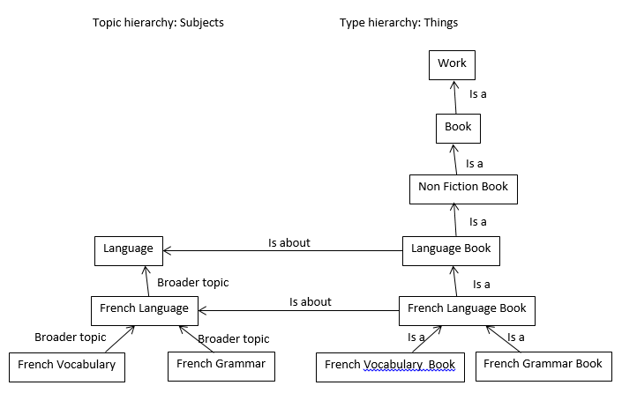
Topic Relations

Slide 99
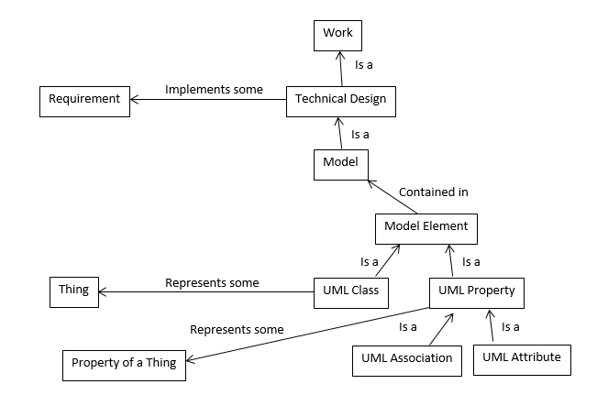
Topic Relations: Mapping

Slide 100
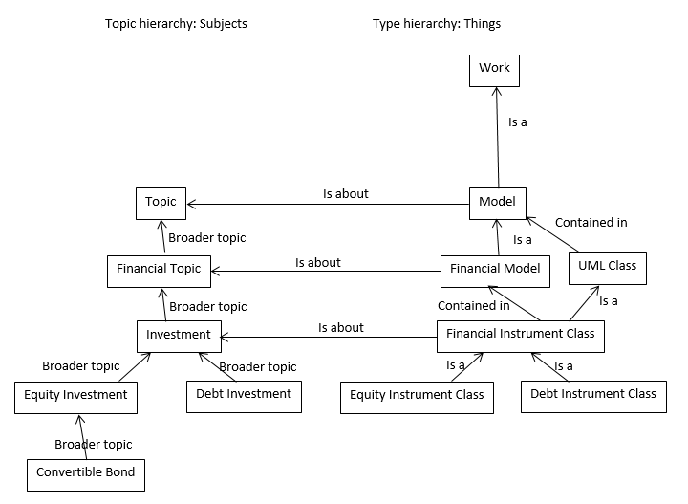
Topic Relations: Financial

Slide 101
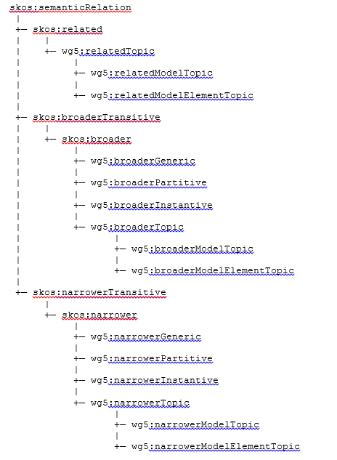
Suggested Extensions
Insert “broaderMatch” to map across concept schemes
Insert “narrowerMatch” to map across concept schemes

Slide 102
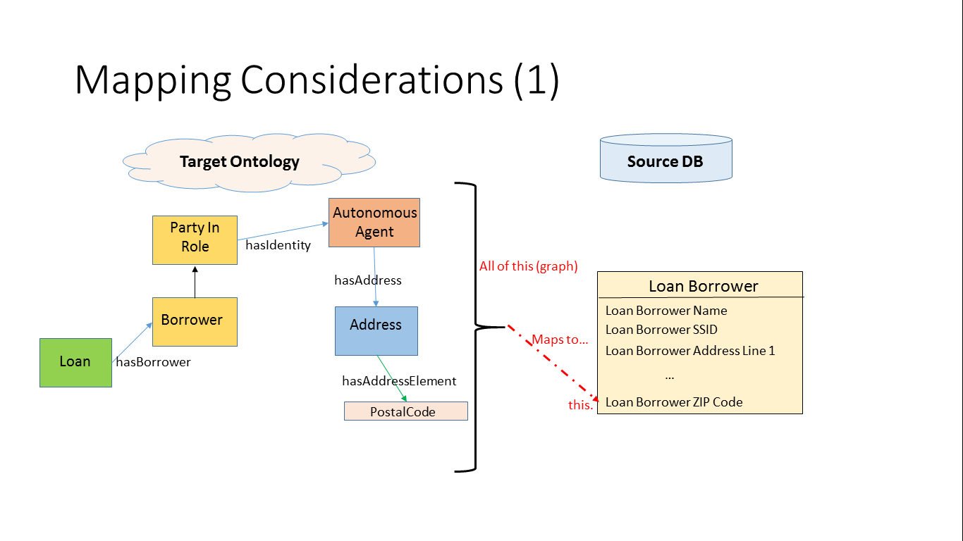
Mapping: Ontology to Data Model

Slide 103
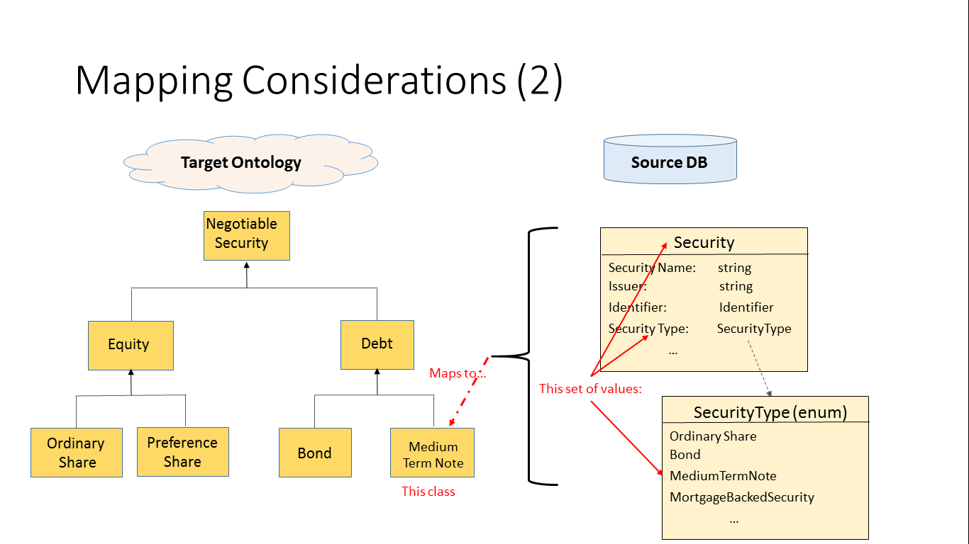
Mapping: Data Model to Ontology

Slide 104
3. Reasoning with Semantic Web Applications
Logical Ontologies – Design Guidelines
Stand-alone ontology design techniques and practice
What works with an enterprise conceptual ontology and what doesn’t?
Striking the balance!

Slide 105
Application vs. Reference Ontology
Application Ontology
  Built to support a particular application (use case)
  Reused rather than define terms
  Skeleton structure to support application
  Terms defined refine or create new concepts directly or through new classes based on inference
Reference Ontology
  Intended as an authoritative source
  True to the limits of what is known
  Used by others

Slide 106
Internal Consistency Semantics
Graph has logical relations between elements
These correspond to the relations between things in reality
Automated reasoning checks the “deductive closure” of the graph for consistency and completeness

Slide 107


Internal Consistency Semantics
Graph has logical relations between elements
These correspond to the relations between things in reality
Automated reasoning checks the “deductive closure” of the graph for consistency and completeness

Slide 108
Internal Consistency Semantics
The more detailed logic there is in the application ontology, the more confident we can be that it reflects only one set of things and their relation in reality
  Like Jabberwocky
  Or a crossword solution
This allows for stand-alone ontologies to do very powerful processing of knowledge in an application
This is not incompatible with the techniques described for conceptual ontology modelling – IFF it is done right!
However, some techniques which are appropriate for stand-alone operational ontologies would not be compatible with a conceptual enterprise ontology
Decide whether to have application and conceptual ontologies in separate namespaces, or satisfy both sets of requirements in one namespace

Slide 109
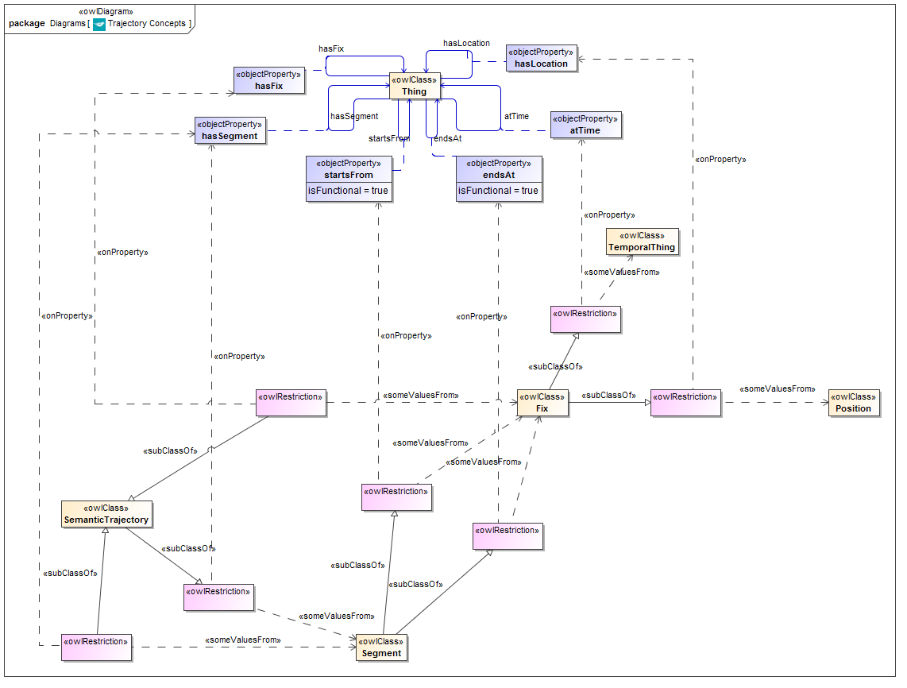
Example: Trajectory Ontology
Illustrated using Visual Ontology Modeler from Thematix

Slide 110
Property Domains and Ranges
Application (operational) ontology:
  Make the domain and / or range as general as possible (e.g. Thing) so it can be reused later
  Corresponds to a very “vocabulary” centric approach to ontology development (reuse common words with less dependence on their meaning)
Enterprise conceptual ontology:
  Domain: the most general class of thing which could possibly have this property
  Range: the most general class of thing in terms of which this property may be framed

Slide 111
Conceptual versus Operational Ontology
Technique | Conceptual | Operational
Deep subsumption hierarchy (taxonomy) | YES | Not advised
Properties with no domain and range | NO | YES
Re-use of underspecified properties | NO | With caution
Restrictions on classes | Enough to disambiguate | As much as possible
Cascades of restrictions (restrictions on restrictions / unions) | Minimal | YES
Property chains | YES | If possible
Property characteristics | YES | Subject to operational constraints

Slide 112
Summary
Conceptual ontologies: knowledge representation principles
  Use the KR and Applied Ontology literature!
  Think of meaning
  Ground concepts in semantic primitives
Syntax is not semantics

Slide 113
Thank You!
One Day Conference
  London – 20 May
    GBP 95 if booked before 17 April (then 145)
  USA – contact Mike for details / express interest
Modular on line training
  9 sessions based on the structure of this webinar
Chat Log from today’s call will be answered and the answers circulated to attendees
www.hypercube.co.uk

